Slide 1


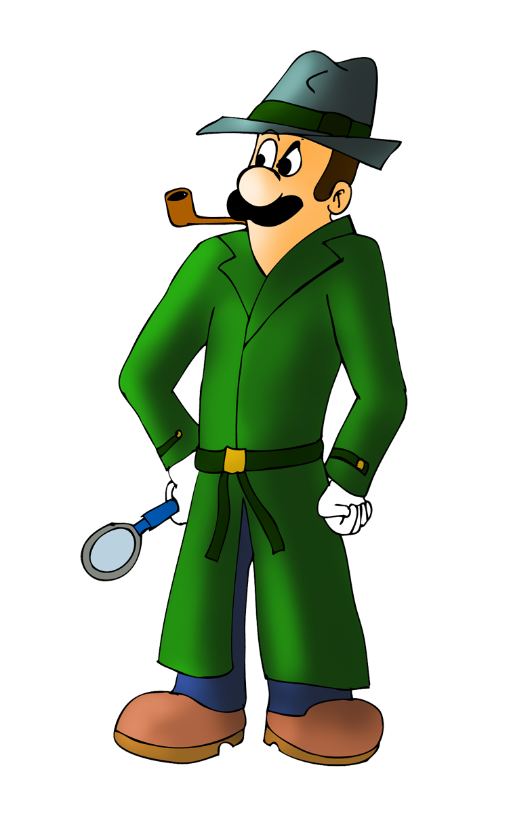
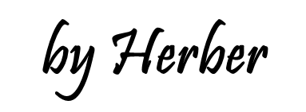
Who is right?
COUNTABLE AND UNCOUNTABLE NOUNS

Slide 2

Who is right, Mr. How Much or Mr. How Many?
Click on the right option to complete the questions.
This case is mine!
No way. It’s mine!

Slide 3
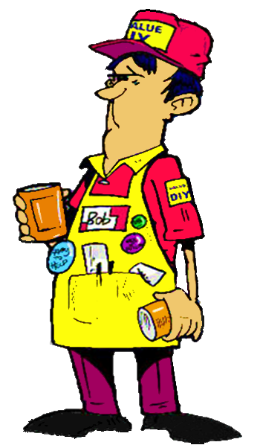
_____________ food did he steal?
How much
Someone stole food and drinks
Oh no, I was wrong!
How many
How much
NEXT

Slide 4


_____________ apples did he steal?
How many
He stole some apples
How many
Oh no, I was wrong!
How much
NEXT

Slide 5
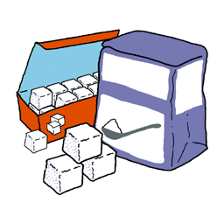
_____________ sugar did he steal?
How much
He stole some sugar
Oh no, I was wrong!
How many
How much
NEXT

Slide 6

_____________ bottles of water did he steal?
How many
He stole some bottles of water
How many
Oh no, I was wrong!
How much
NEXT

Slide 7

_____________ bananas did he steal?
How many
He stole some bananas
How many
Oh no, I was wrong!
How much
NEXT

Slide 8

_____________ milk did he steal?
How much
He stole some milk
Oh no, I was wrong!
How many
How much
NEXT

Slide 9

_____________ cheese did he steal?
How much
He stole some cheese
Oh no, I was wrong!
How many
How much
NEXT

Slide 10

_____________ tomatoes did he steal?
How many
He stole some tomatoes
How many
Oh no, I was wrong!
How much
NEXT

Slide 11

_____________ wine did he steal?
How much
He stole some wine
Oh no, I was wrong!
How many
How much
NEXT

Slide 12

_____________ orange juice did he steal?
How much
He stole some orange juice
Oh no, I was wrong!
How many
How much
NEXT

Slide 13

_____________ cakes did he steal?
How many
He stole some cakes
How many
Oh no, I was wrong!
How much
EXIT

