Slide 1
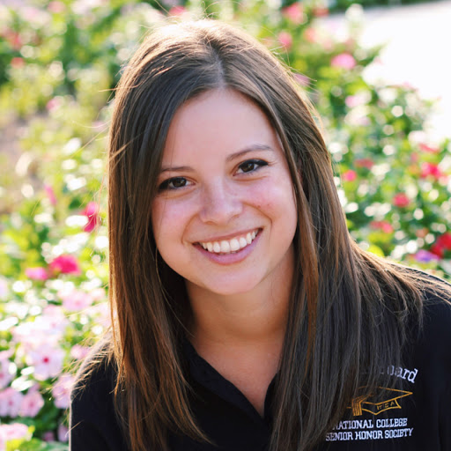
Hello! My name’s Eileen Farry.

Slide 2

Today I’m going to …
go to New York
go shopping
go to a café

Slide 3
https://www.youtube.com/watch?v=u55rQUs_6XQ

Slide 4
Now make your own dialogue.
Let’s go shopping!
Ok. What do we need?
We need …
…..
….
……
…..
Vocabulary list:
some
a packet of
a bottle of
any
a/an

Slide 5
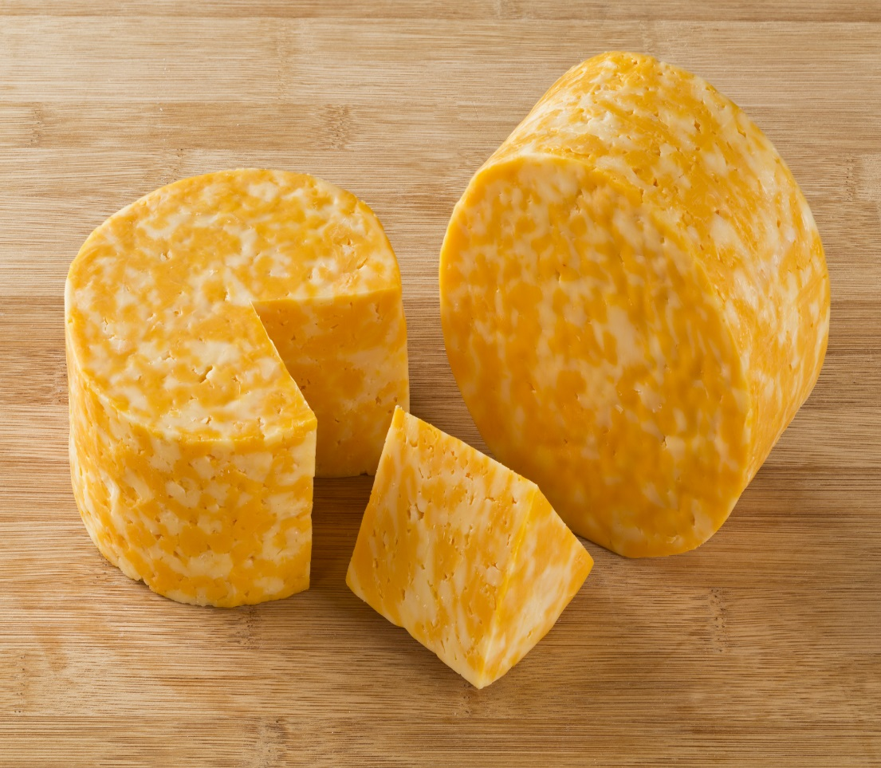
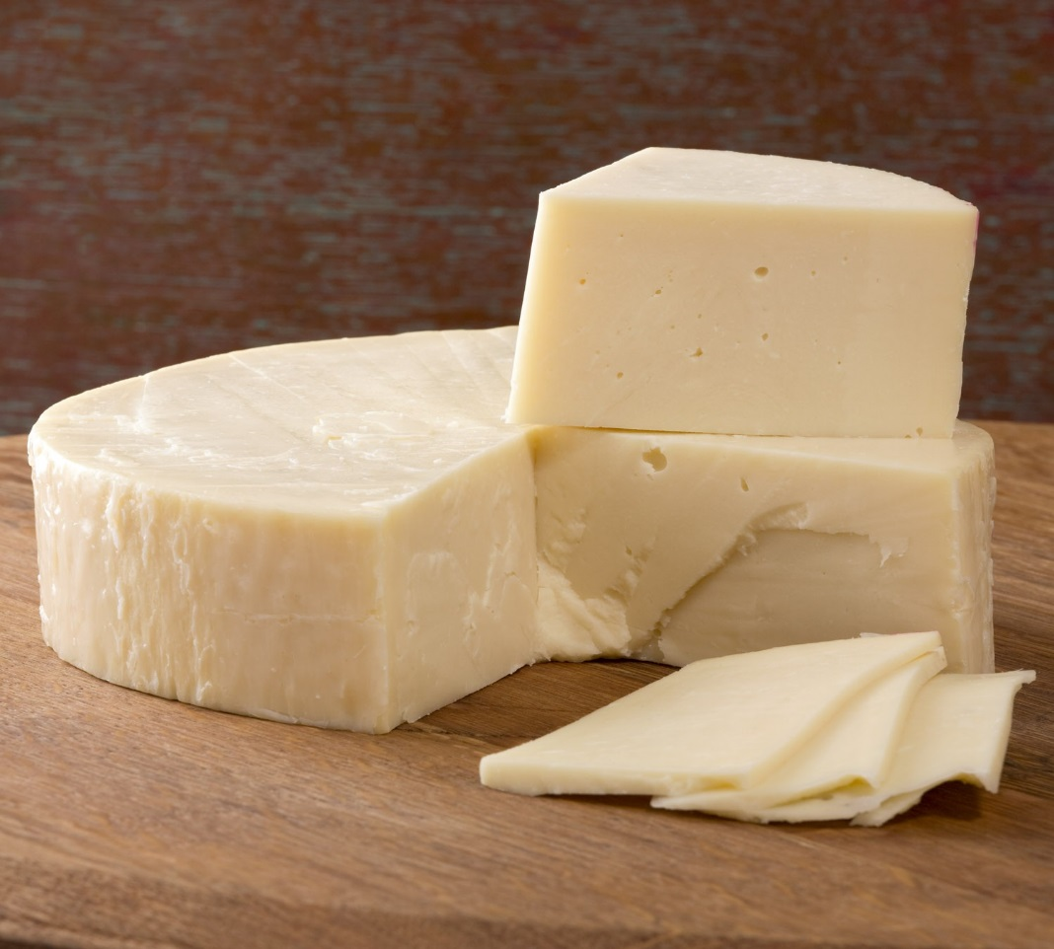
Some more cheese
Colby-Jack
Provolone

Slide 6
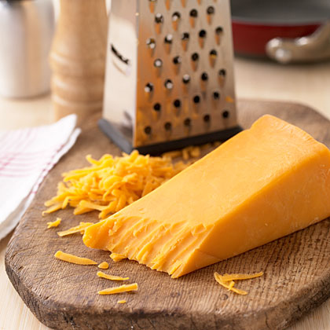
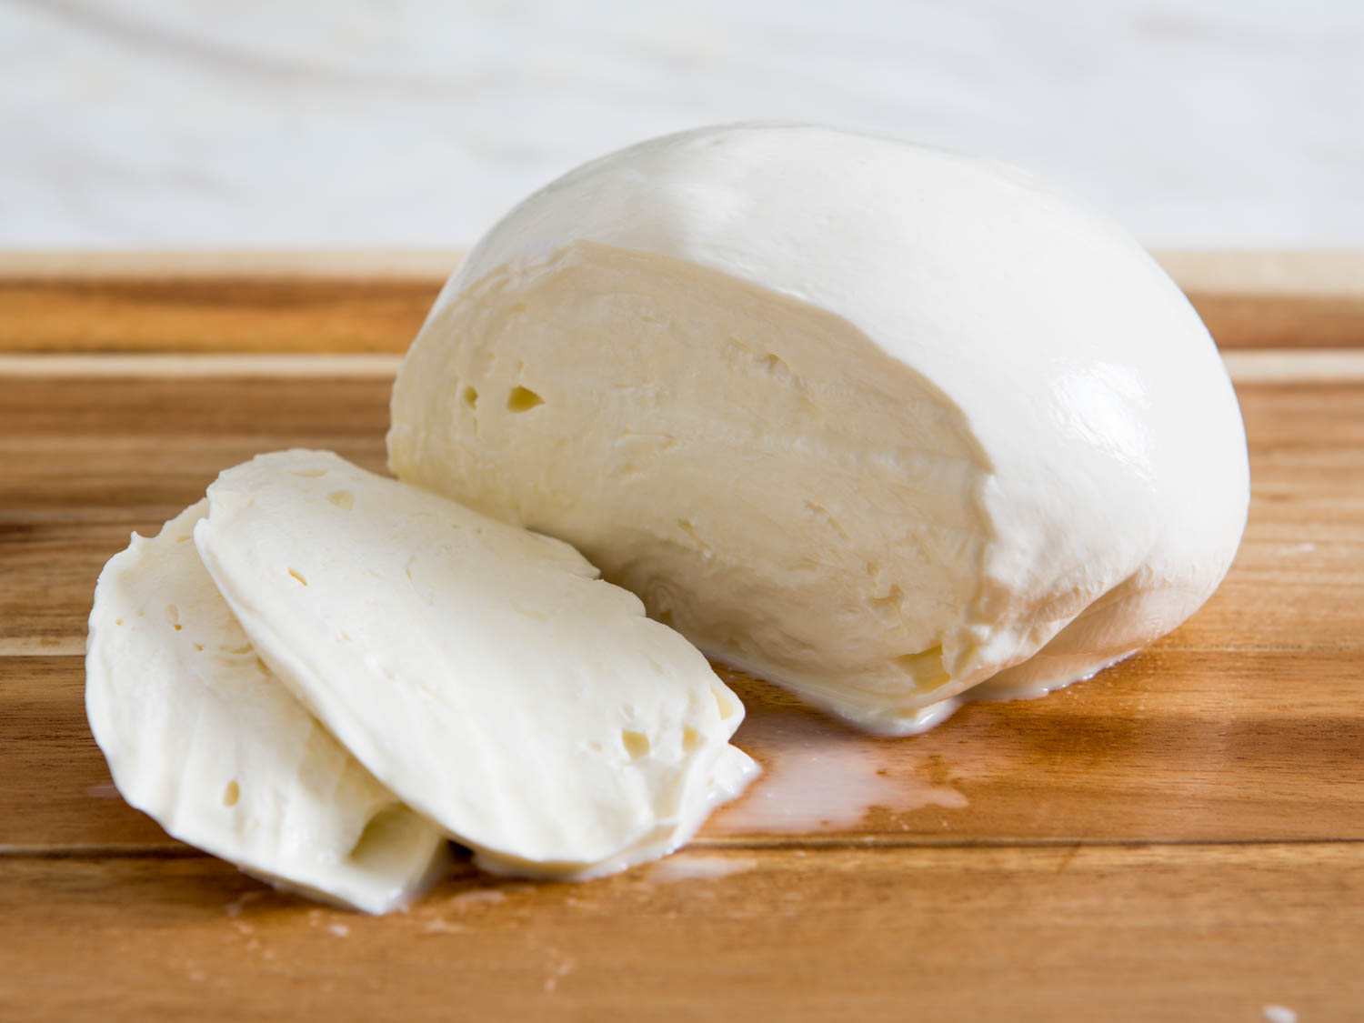
Cheddar
Mozzarella

Slide 7

Some really great cheese!

Slide 8
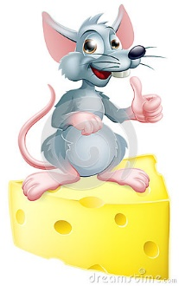
The mouse is fine!
Thank you for the lesson!

