Slide 1
My feelings
Including
audio vocabulary

Slide 2
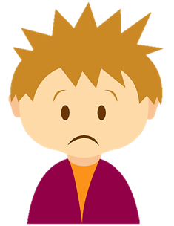
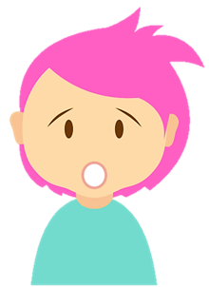
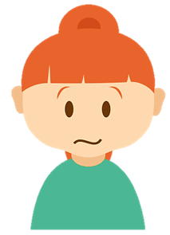
glad
sad
embarrassed
comfortable
excited
surprised
worried
cross
confused

Slide 3
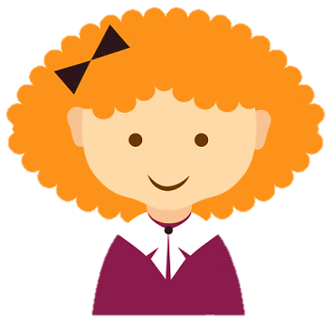
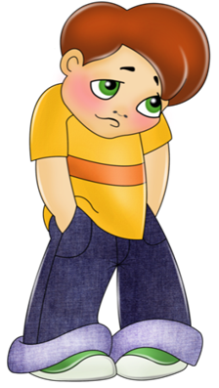
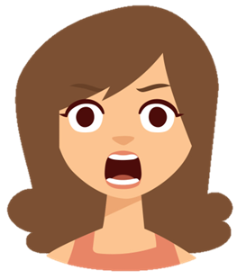
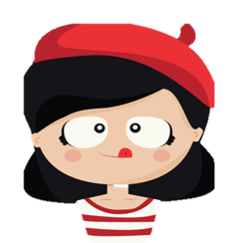
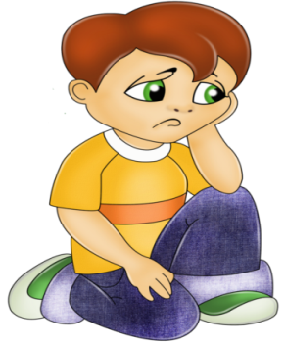
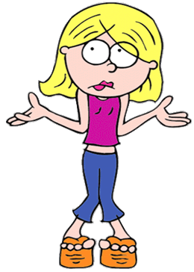
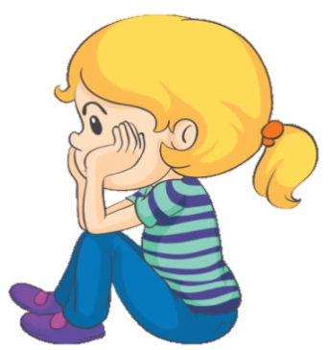
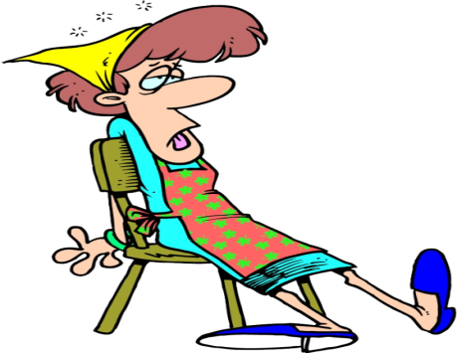
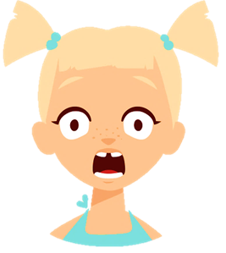
happy
shy
shocked
hungry
bored
puzzled
offended
tired
scared

Slide 4
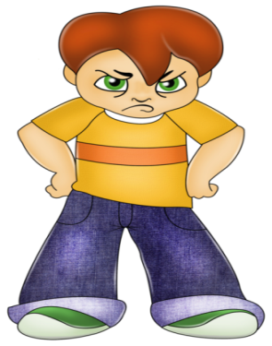
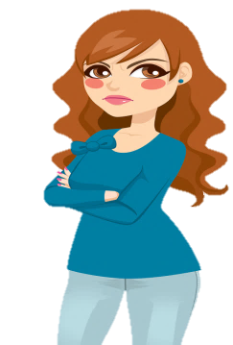
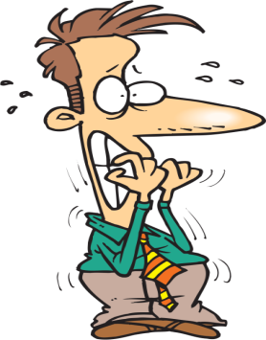
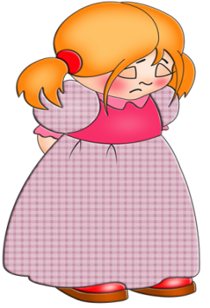
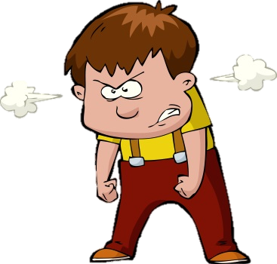
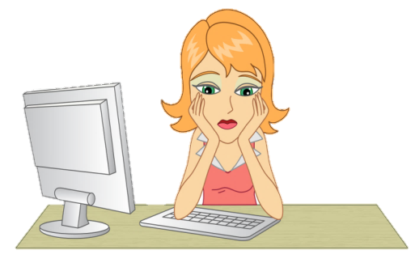
proud
angry
jealous
nervous
guilty
curious
furious
anxious
stressed

Slide 5
How do you feel when you have an exam?
I feel worried..

Slide 6
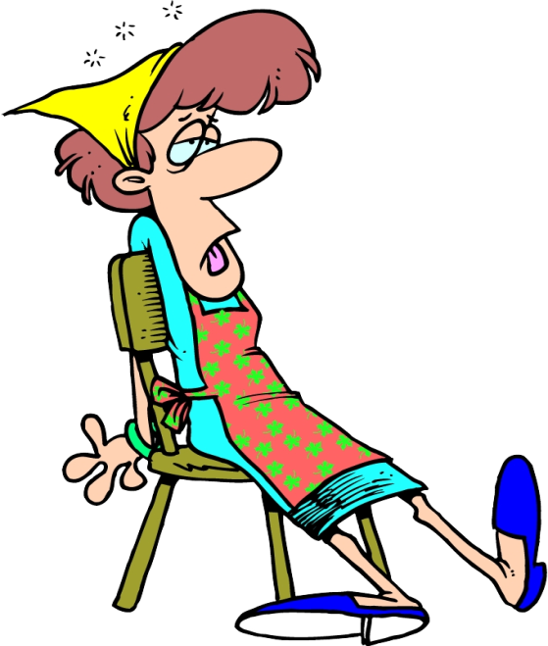
How do you feel when you work for a long time?
I feel tired..

Slide 7
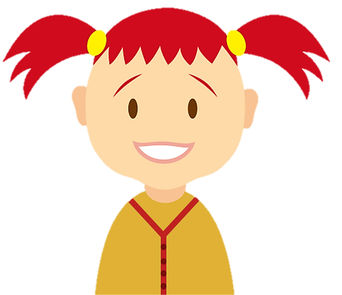
How do you feel when you are on holiday?
I feel excited..

Slide 8
How do you feel when you have nothing to do?
I feel bored..

Slide 9
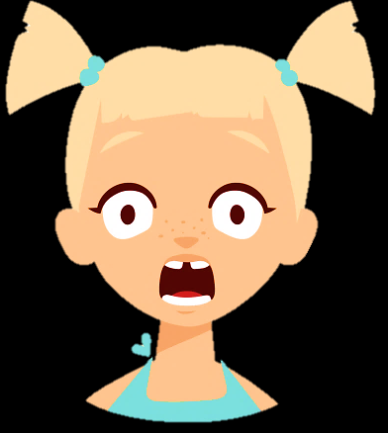
How do you feel when you are alone in the dark?
I feel scared..

Slide 10
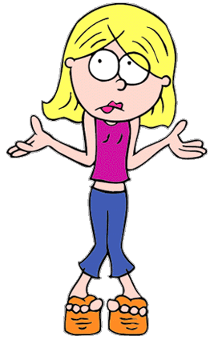
How do you feel when you don’t understand something?
I feel puzzled..

Slide 11
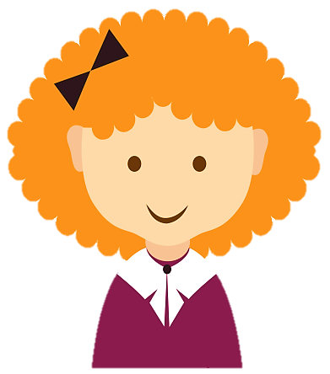
How do you feel when you fight with your best friend?
I feel sad..

Slide 12
How do you feel when you’ve done well in your exam?
I feel happy..

Slide 13
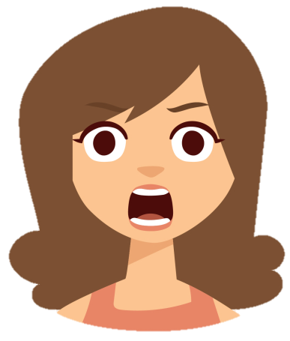
How do you feel when everyone you ask about it tells you something different?
I feel confused..

Slide 14
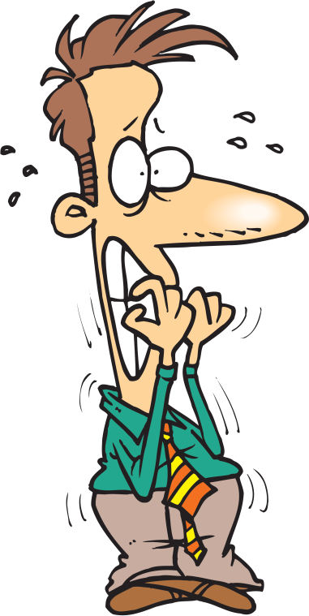
How do you feel when you have to talk in front of 100 people?
I feel nervous..

Slide 15
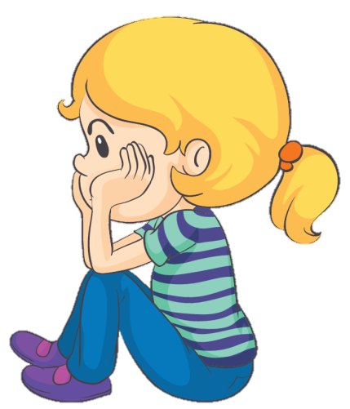
How do you feel when a friend of your family has been arrested for murder?
I feel shocked..

Slide 16
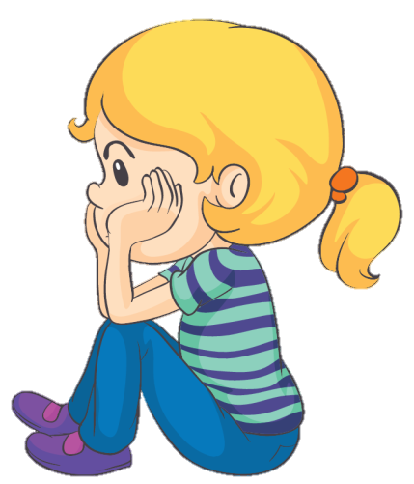
How do you feel when your dog did the mess on the carpet?
I feel angry..

Slide 17
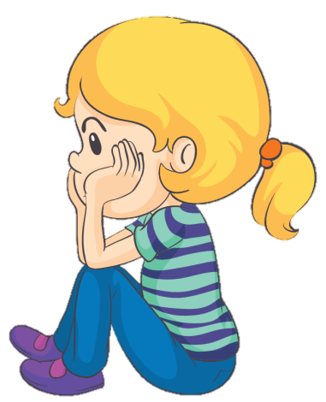
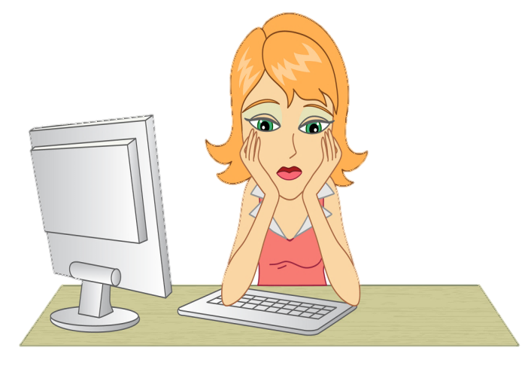
How do you feel when you are very busy at work and you don’t have any time to relax ?
I feel stressed..

Slide 18
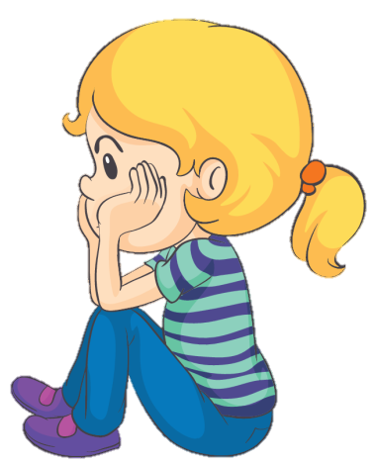
How do you feel when your friends don’t want to play with you?
I feel offended..

Slide 19
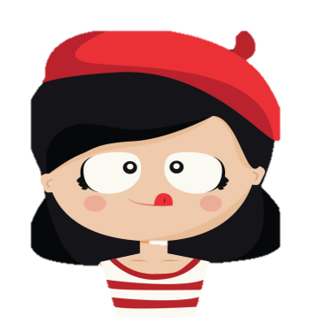
How do you feel when you spilled water on your jeans?
I feel embarrassed.

Slide 20
How do you feel when you haven’t eaten anything all day?
I feel hungry.

Slide 21
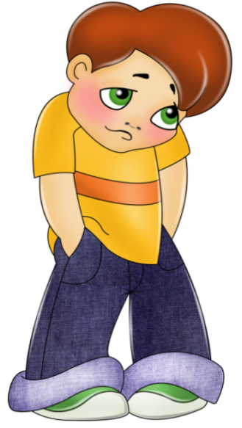
How do you feel when you won a lot of money at the lottery?
I feel surprised.

Slide 22
How do you feel when you won a sport competition?
I feel proud.

Slide 23
How do you feel when you broke your mom’s vase?
I feel guilty.

Slide 24
How do you feel when you want to have the dress your best friend has?
I feel jealous.

Slide 25
How do you feel when you have to recite your own poem in front of all class?
I feel shy.

