Slide 1
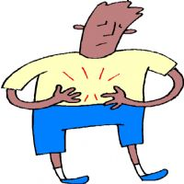
He has got a stomachache.

Slide 2
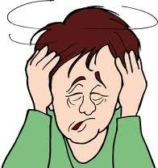
He has got a headache.

Slide 3

He has got a toothache.

Slide 4
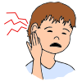
He has got an earache.

Slide 5

He has got a cold.

Slide 6
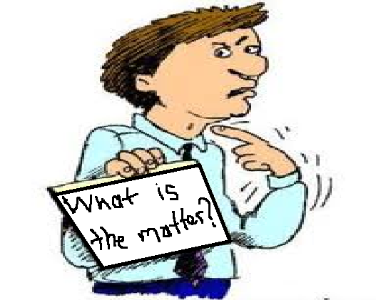
He has got a sore throat.

Slide 7
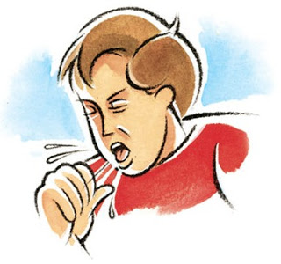
He has got a cough.

Slide 8

He feels good/fine.

Slide 9
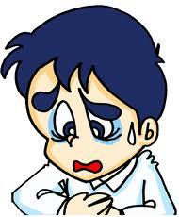
He feels sick.

Slide 10
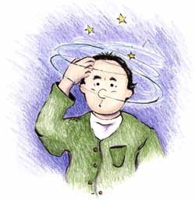
He feels dizzy.

