Slide 1


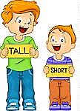
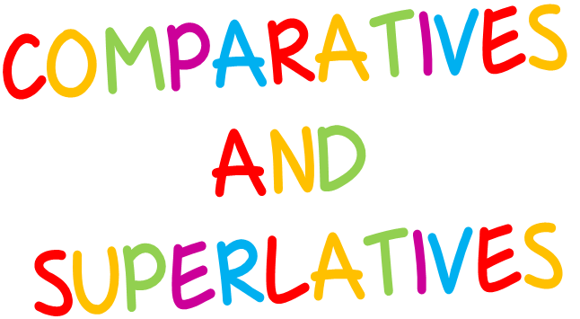

START

Slide 2

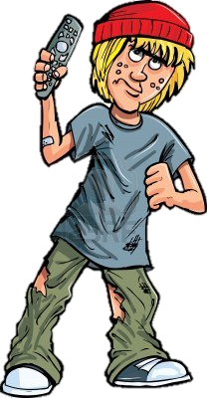

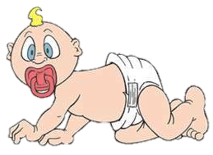
Brad
Paul
Tim
Who is older than Paul?
Click on the correct picture
NEXT

Slide 3
Brad
Paul
Tim
Who is the youngest?
NEXT

Slide 4
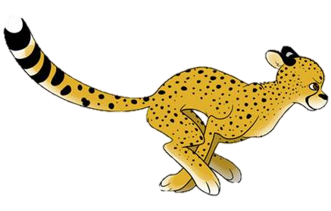
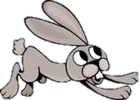
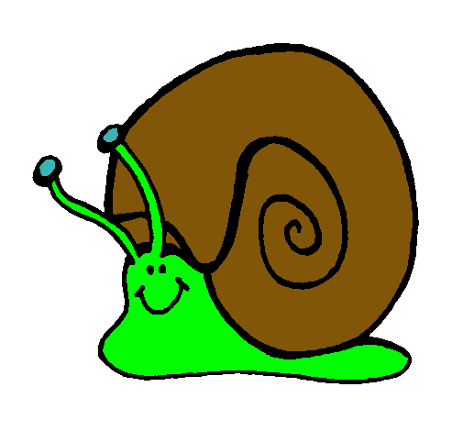
The cheetah
The hare
The snail
Who is slower than the hare?
NEXT

Slide 5

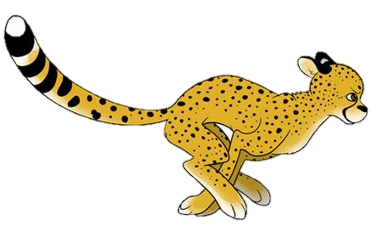
The hare
The snail
The cheetah
Who is the fastest?
NEXT

Slide 6

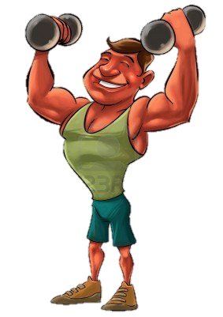
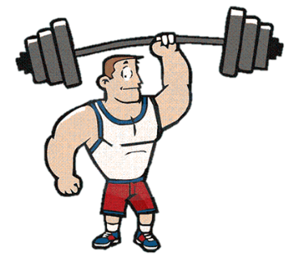
Bob
Dave
John
Who is stronger than Dave?
NEXT

Slide 7

Bob
John
Dave
Who is the weakest?
NEXT

Slide 8



Eiffel tower
Burj Khalifa
Big Ben
Which is lower than Eiffel tower?
NEXT

Slide 9

Eiffel tower
Burj Khalifa
Big Ben
Which is the highest?
NEXT

Slide 10
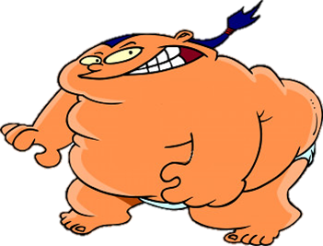
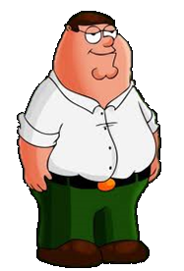
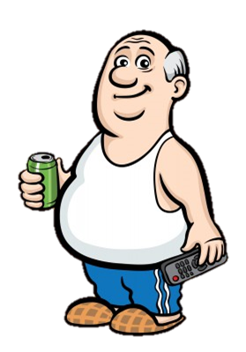
Steve
Peter
Sato
Who is fatter than Peter?
NEXT

Slide 11
Steve
Peter
Sato
Who is the fattest?
NEXT

Slide 12
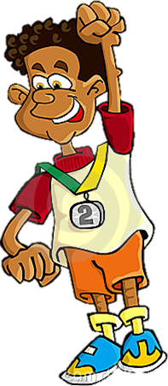
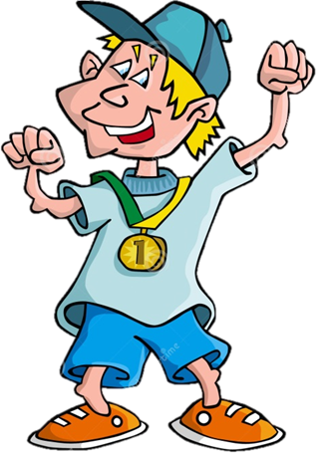
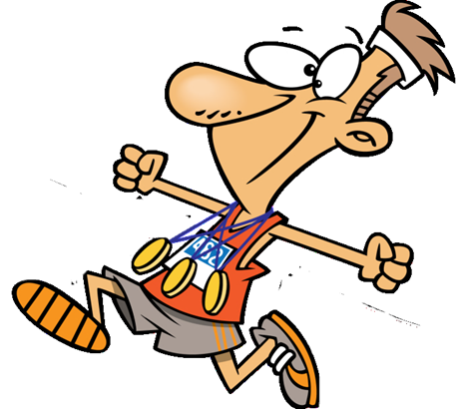
Luke
Rick
James
Who is worse than Luke?
NEXT

Slide 13
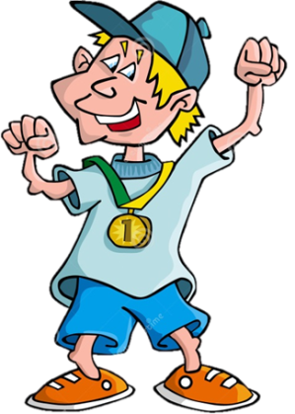
Steve
Rick
James
Who is the best?
NEXT

