Slide 1
The USA vs the UK
vs.

Slide 2
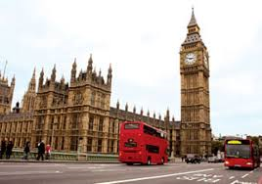
Washington DC is the capital of…
London is the capital of…

Slide 3
The national day in this country is celebrated on July, the 4th…
CHALLENGE: What event do Americans celebrate on this date? What do British people celebrate?
The national day in this country is celebrated on the 2nd Saturday of June…

Slide 4
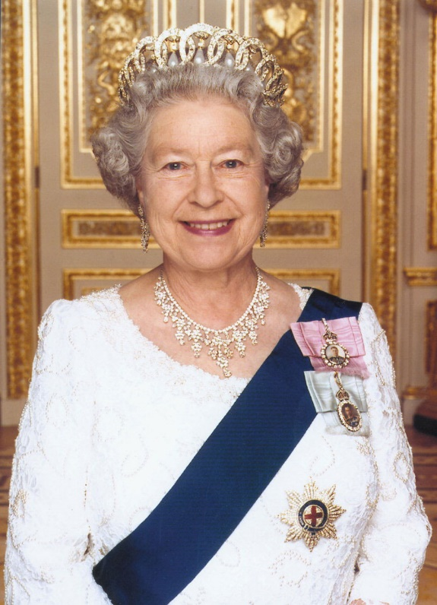
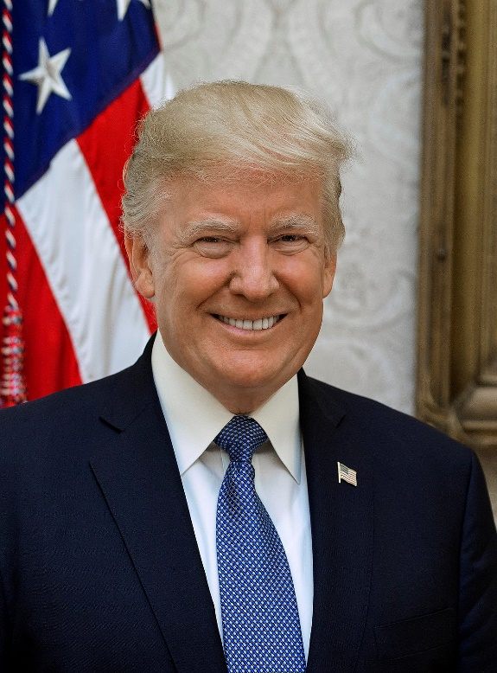
Elizabeth II is the Queen of…
Donald Trump is the president of…

Slide 5
This union is made of 50 states…
CHALLENGE: Give me the name of 5 American states and the 4 « countries » which are part of the UK.
This union is made of 4 « countries »…

Slide 6
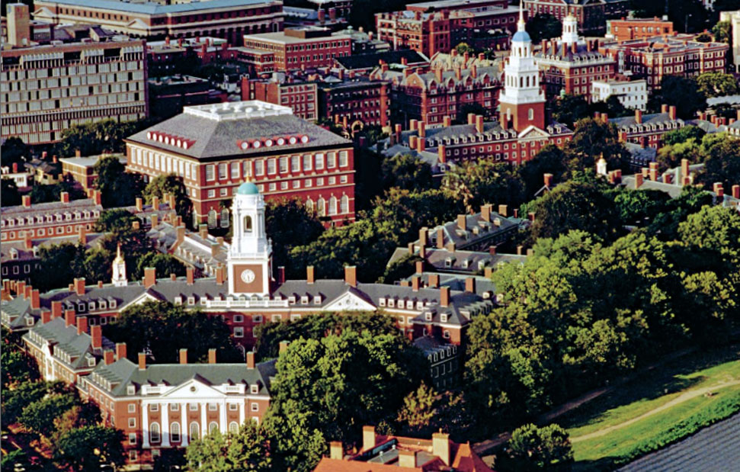
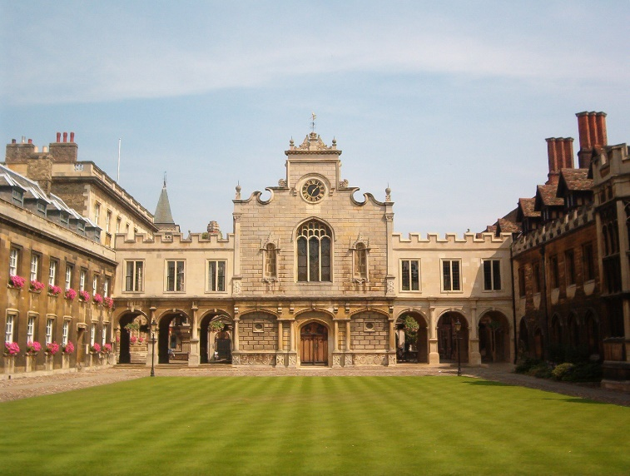
Harvard is one of the best universities in…
CHALLENGE: Where is Harvard?
Cambridge is one of the best universities in…

Slide 7
In this country, people pay with dollars…
In this country, people pay with pounds…

Slide 8
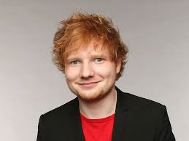
Ed Sheeran is from…
Tailor Swift is from…

Slide 9
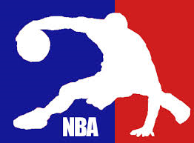
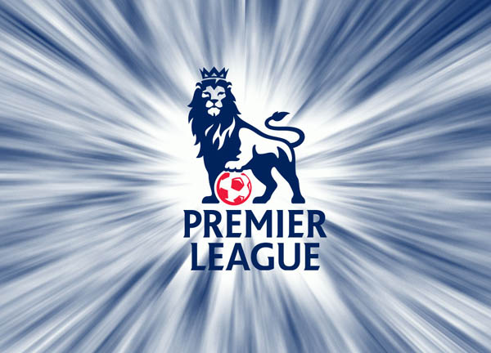
The NBA championship takes place in…
CHALLENGE: What sport are played in those championships?
The Premier League championship takes place in…

Slide 10
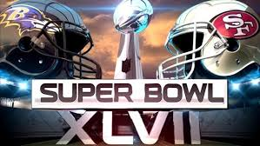
Wimbledon is a tennis championship taking place in…
The superbowl is a football championship taking
place in…

Slide 11
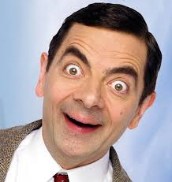
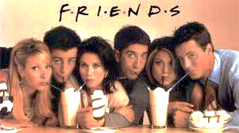
« Mr Bean » was a very famous series in…
« Friends » was a very famous series in…

Slide 12
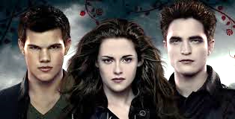
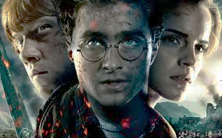
The saga «Twilight » was written by Stephenie Meyer who is…
The saga« Harry Potter » was written by JK Rowling who is…

Slide 13
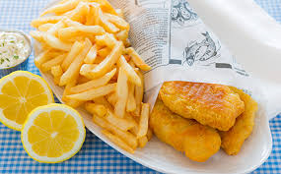
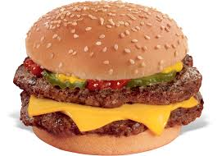
The fish and chips is the most eaten dish in…
The cheeseburger is the most eaten dish in …

