Slide 1
The Rabbit and the Tuttle
A Moral Story

Slide 2
Once upon a time, there was a turtle that enjoyed taking walks around the lake. While walking one day, the turtle met a speedy rabbit.

Slide 3
“I think slow-movers should not use the road,” said the rabbit laughing. “The road is for everyone,” said the turtle. “I’ll tell you what” challenged the rabbit “Let’s have a race.” The turtle agreed and they decided to run to the other side of the forest.

Slide 5
The next day, all the animals gathered to watch the race. The race started. The rabbit ran ahead as fast as lightning. The turtle was lagging behind. The distance between them was getting bigger and bigger, raising the rabbit’s self-confidence.

Slide 7
After running for a little the rabbit noticed carrots beside the road. “Oh, my favourite! I didn’t have breakfast today,” said the rabbit. “I’ll eat these delicious carrots, rest for a while, then I’ll resume the race and I’ll be the winner, of course. The turtle is still too far from me!”

Slide 8
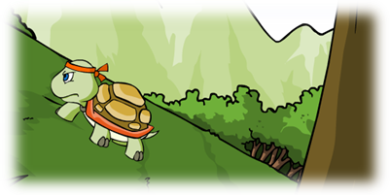

Slide 9
Meanwhile, the turtle was focusing on the road. She never stopped and took great pains to continue. As she neared the finish line, the animals hailed and cheered her in support. At the same time, the rabbit awoke from his sleep. He decided to run again. He started to skip and jump.

Slide 10
Suddenly, he stopped and couldn’t believe his eyes: the turtle was almost at the finish line! “That’s impossible!” cried the rabbit. He tried to run faster but he couldn’t because he was so full. The turtle crossed the finish line and won the race.

Slide 12
The turtle looked at the rabbit and said “Slow but steady wins the race.” The arrogant rabbit realized his mistake. He felt sorry for making fun of the hard-working turtle. So, he decided to apologize to her.

Slide 13
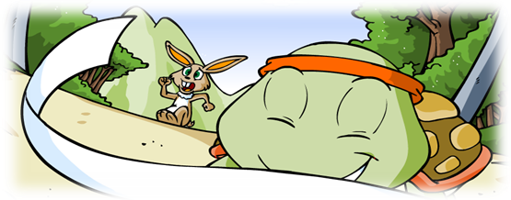

Slide 14
1. Read the story and complete the following table:
Principal characters: | Place: | Time:

Slide 15
2. Focus on paragraph 2 and find idiom meaning:
To walk very slowly:
To run very fast:

Slide 16
3. Tick the right sentence that better describe the rabbit and the turtle :
The turtle and the rabbit are fast and steady. 
The rabbit is fast and lazy whereas the turtle is slow and hardworking 
The turtle is fast and hardworking but the rabbit is slow and kind. 

Slide 17
4.Match each sentence with its function:
I think slow-movers should not use the road.
Let’s have a race!
I apologize for making fun of you.
The arrogant rabbit lost the race to the hard-working turtle.
Expressing agreement
Expressing opinion
Describing
Apologizing (= saying sorry)
Making a suggestion

Slide 18
5. Read the last paragraph again and take out the moral lesson of the story. (Proverb)
Moral: never underestimate the weakest opponent.

Slide 19
6. The rabbit decided to apologize to the turtle for his mis-behaviour. Imagine the dialogue. Work with a friend and be ready to enact the conversation.
Rabbit:
Turtle:

Slide 20
The End

