Slide 1
Haiku
Japanese poetry

Slide 2
We are learning to understand to:
understand origins and structure of a Haiku;
to read together, listen to and talk about Haiku poems
experiment with language , using rhythm and imagery to create our own Haiku.

Slide 3
How to Write a Haiku
It is easy to learn to write a haiku, but it can take a lot of practice to learn how to do it well. This lesson will give you the basics for writing your own haiku. It’s up to you to practice by writing a lot of them so you will get very good at it.

Slide 4
What is a Haiku?
A haiku is an unrhymed three-line poem. It is based on a traditional Japanese poetic form. Though there are different ways to write haiku, the traditional pattern in English is to write the first and last lines with five syllables each, and the middle line with seven syllables.

Slide 5
The pattern of syllables looks like this:
Line 1: 5 syllables
Line 2: 7 syllables
Line 3: 5 syllables

Slide 6
Here’s another way to visualize the same thing:
1 2 3 4 5
1 2 3 4 5 6 7
1 2 3 4 5

Slide 7
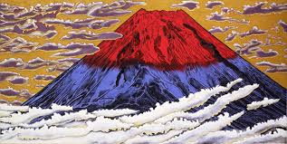
Subject
Most often, haiku poems are about seasons or nature, though you can write your own haiku about anything you like.

Slide 8

Masaoka Shiki (1867-1902)
In the coolness
of the empty sixth-month sky...
the cuckoo’s cry.
the tree cut,
dawn breaks early
at my little window

Slide 9
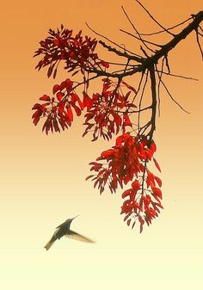
Matsuo Basho (1644-1694)
Autumn moonlight –
a worm digs silently
into the chestnut.
Old pond
a frog jumps
the sound of water

Slide 10
Modern Haiku
If you decide to write a haiku about nature, you will have many more subjects to choose from. You could write about animals, plants, the sky, the ocean, streams, the wind, and so on. Start by selecting a topic, and then decide what you want to say; what observation you want to make about it.

Slide 11
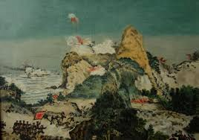
Ency Bearis
Ocean is lovely
With wonderful scenery
Not with tsunami

Slide 12
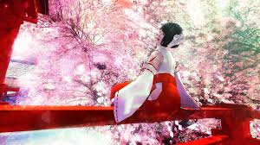
Theme: Spring
As the blue birds sing
I am dreaming about spring
I feel so happy

Slide 13
Summary
Select a type of haiku. Decide if you are going to write a seasonal, nature, or other type of haiku.
Pick a topic. Select one specific season, item in nature, or something else you are going to write about.
Think about what is different about your last line. What observation do you want to make?
Start writing.
Don’t forget to count the syllables as you read to make sure you’ve got the right pattern.
Finally, “center” your poem on the page like the poems in this lesson.

