Slide 1
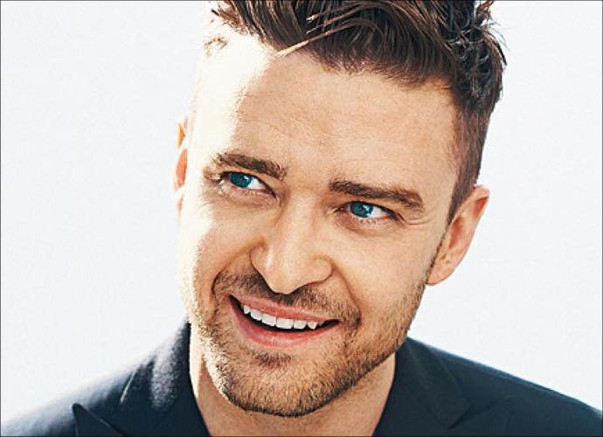
CAN YOU IDENTIFY A FAMOUS PERSON?

Slide 2
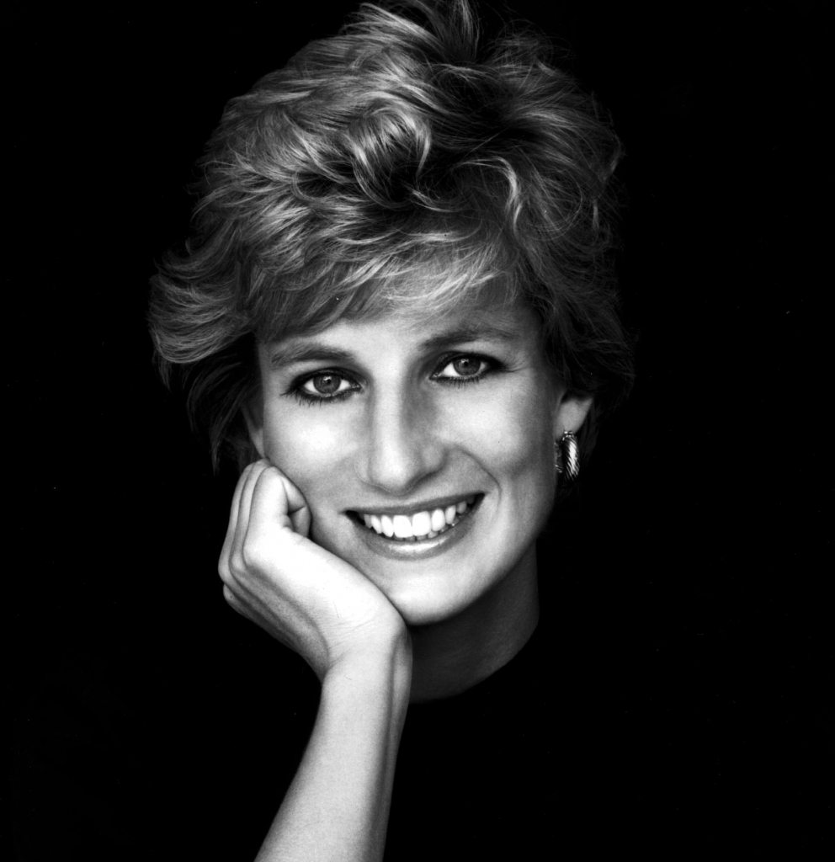
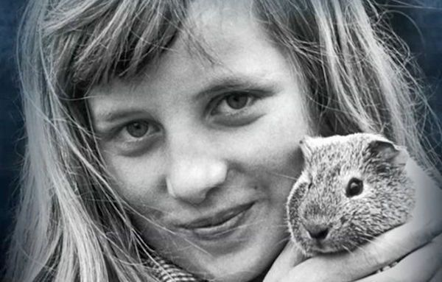
CAN YOU IDENTIFY A FAMOUS PERSON?

Slide 3
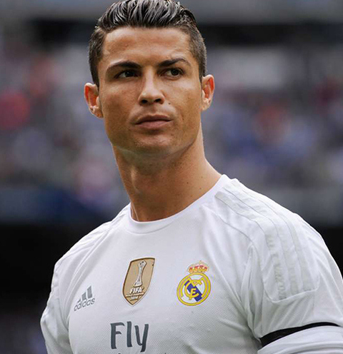
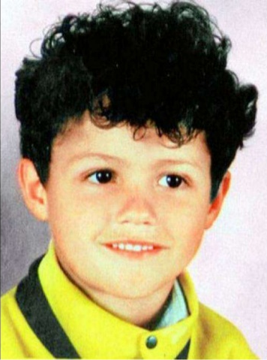
CAN YOU IDENTIFY A FAMOUS PERSON?

Slide 4
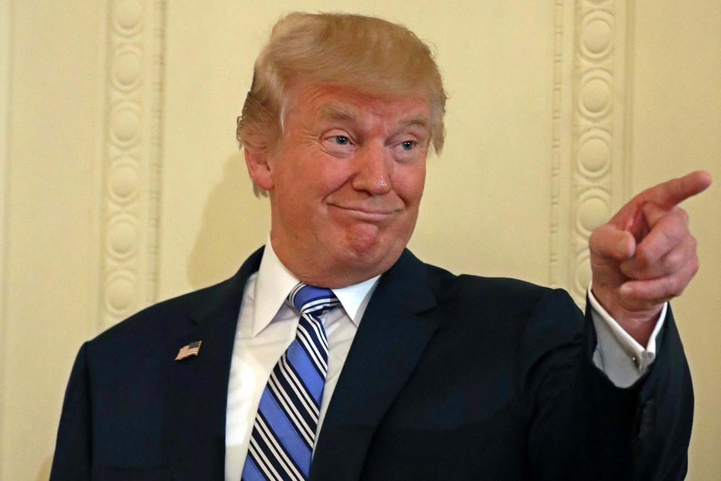
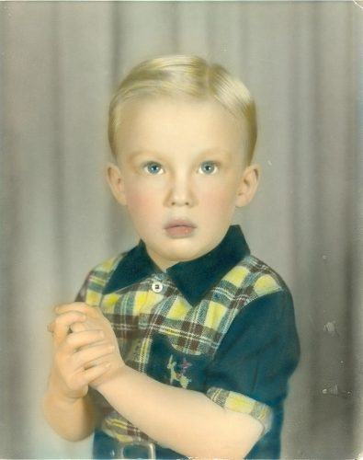
CAN YOU IDENTIFY A FAMOUS PERSON?

Slide 5
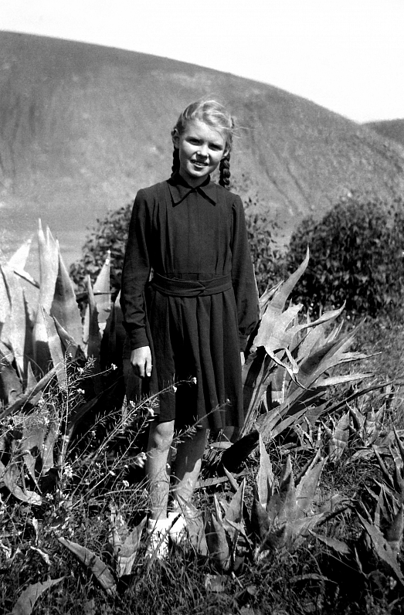
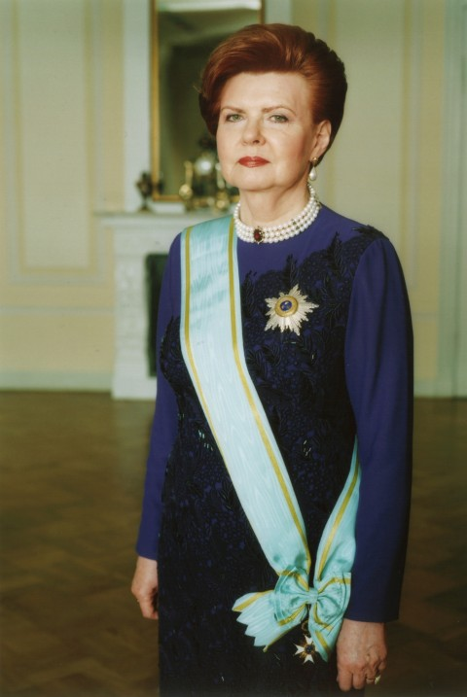
CAN YOU IDENTIFY A FAMOUS PERSON?

Slide 6
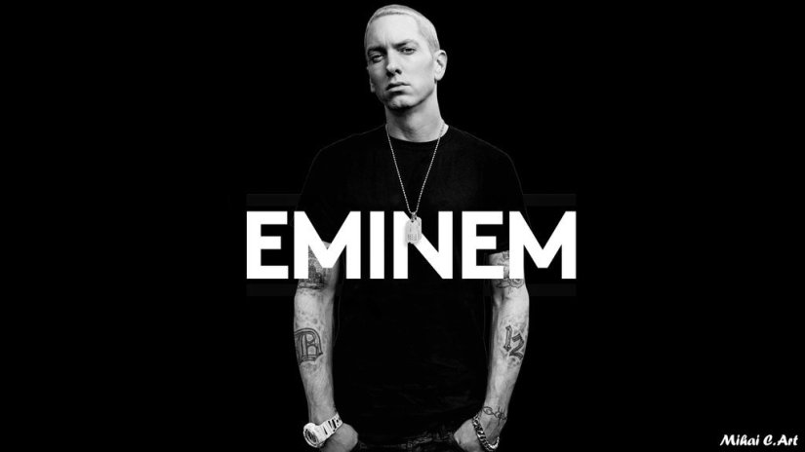
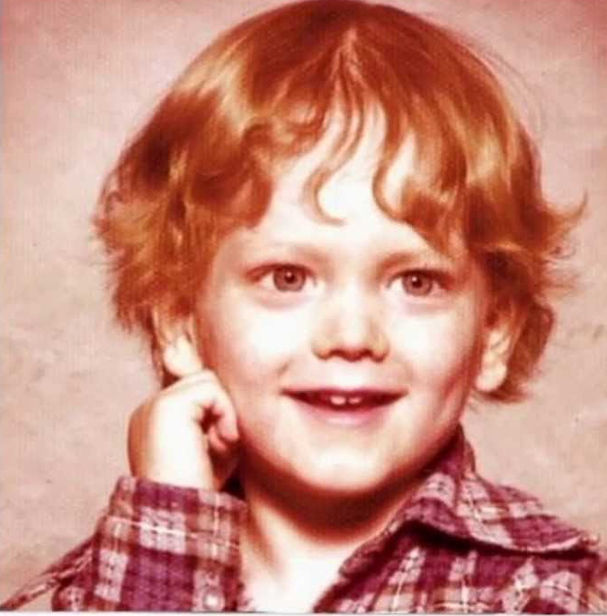
CAN YOU IDENTIFY A FAMOUS PERSON?

Slide 7
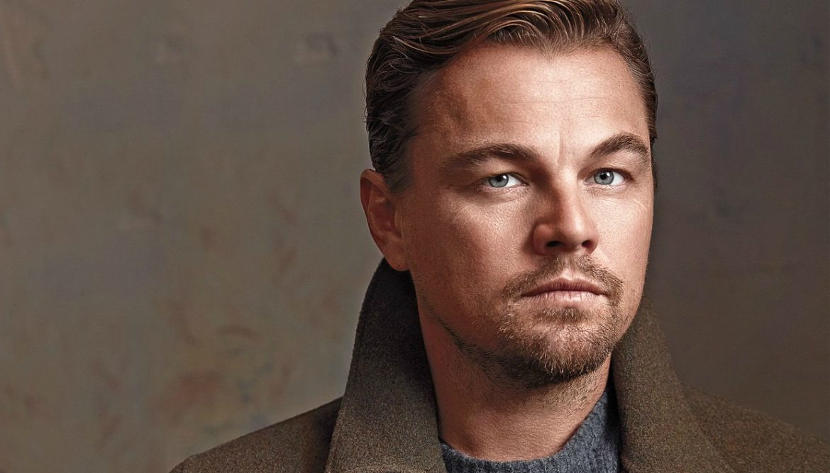
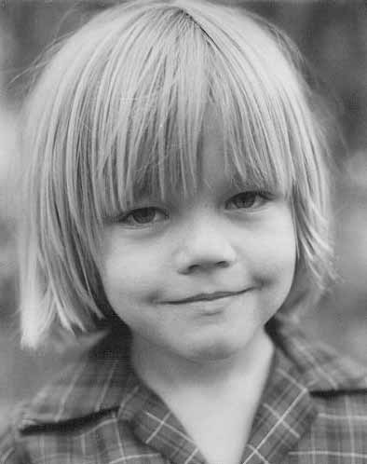
CAN YOU IDENTIFY A FAMOUS PERSON?

