Slide 1
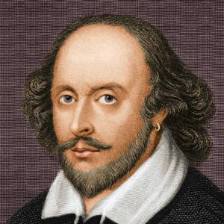
William Shakespeare-450 th Birthday celebration worldwide in 2014
W.Shakespeare often called the English national poet is widely considered the greatest dramatist of all times.

Slide 2
Quick Facts
Name: William Shakespeare
Occupation: Poet,Playwright
Birth Date: April 23, 1564
Death Date: April 23, 1616
Education: King’s New School
Place of Birth: Stratford-upon-Avon,UK

Slide 3
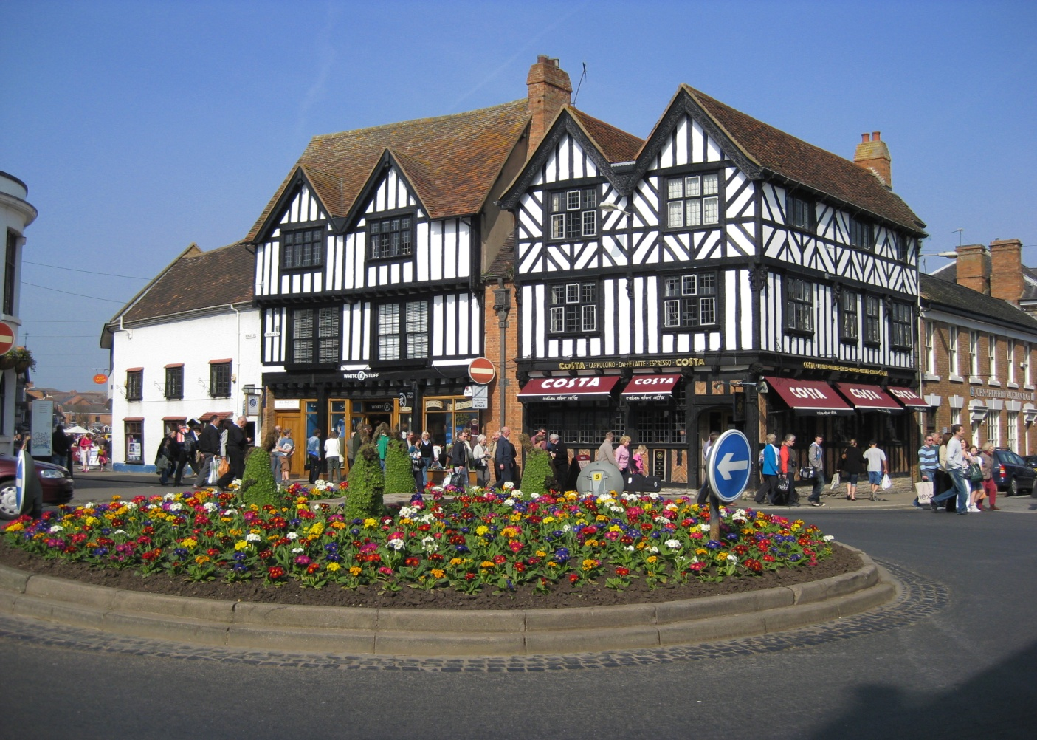
Stratford –upon-Avon
Shakespeare’s birthplace

Slide 4
Some greatest plays
As Well That Ends Well
Antony and Cleopatra
Comedy of Errors
Julius Caesar
King Lear
Macbeth
Midsummer’s Night’s Dream
Othello
Romeo and Juliet

Slide 5
Hamlet’s soliloquy
To be, or not to be: that is the question: Whether ’tis nobler in the mind to suffer The slings and arrows of outrageous fortune, Or to take arms against a sea of troubles, And by opposing end them? To die: to sleep; No more; and by a sleep to say we end…

Slide 6
Congratulations!
Happy Birthday,
Sir William Shakespeare!

