Slide 2
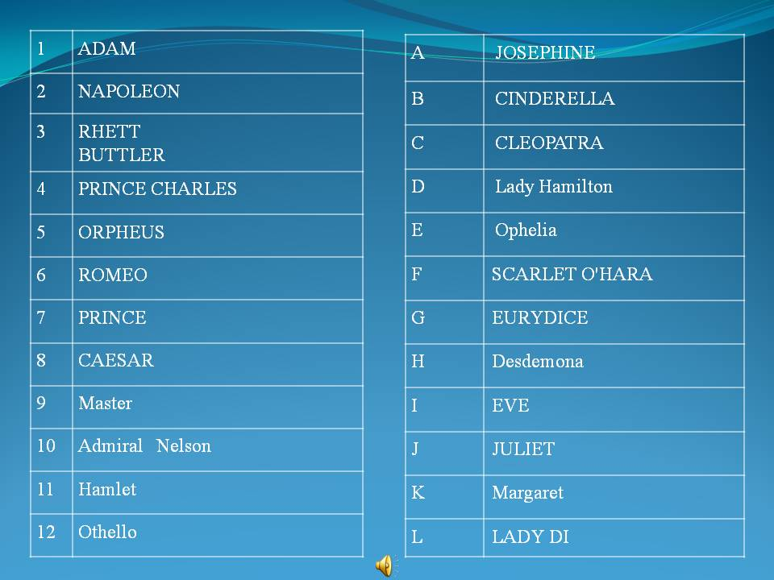
Match the famous couples

Slide 3
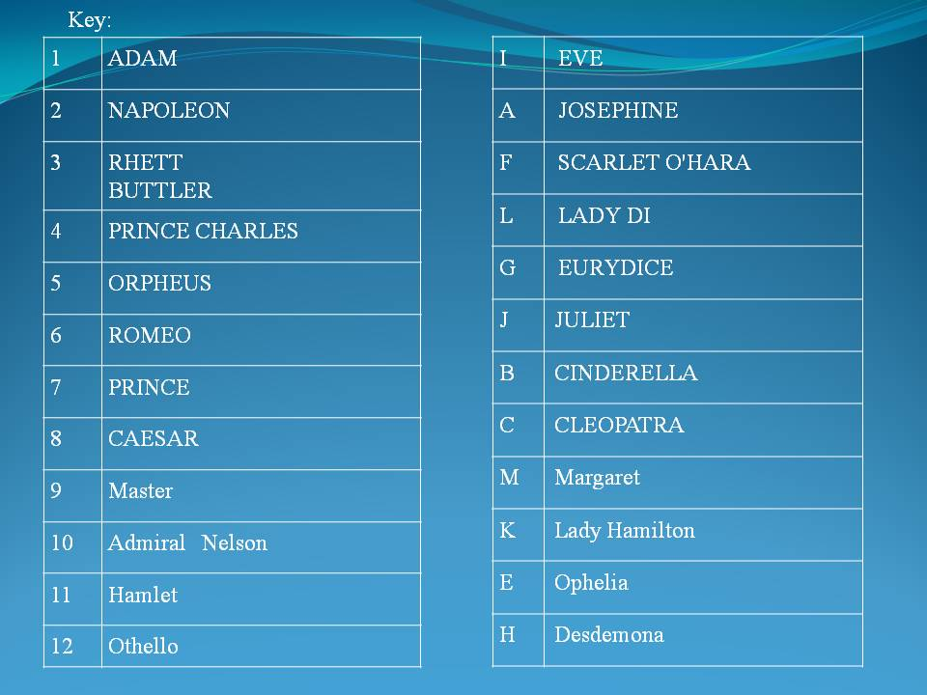
key

Slide 4
Match sayings

Slide 5
key

Slide 6
greetings
Roses are red,
My world is blue.
But if you’ll love me
I’ll love you too

Slide 7
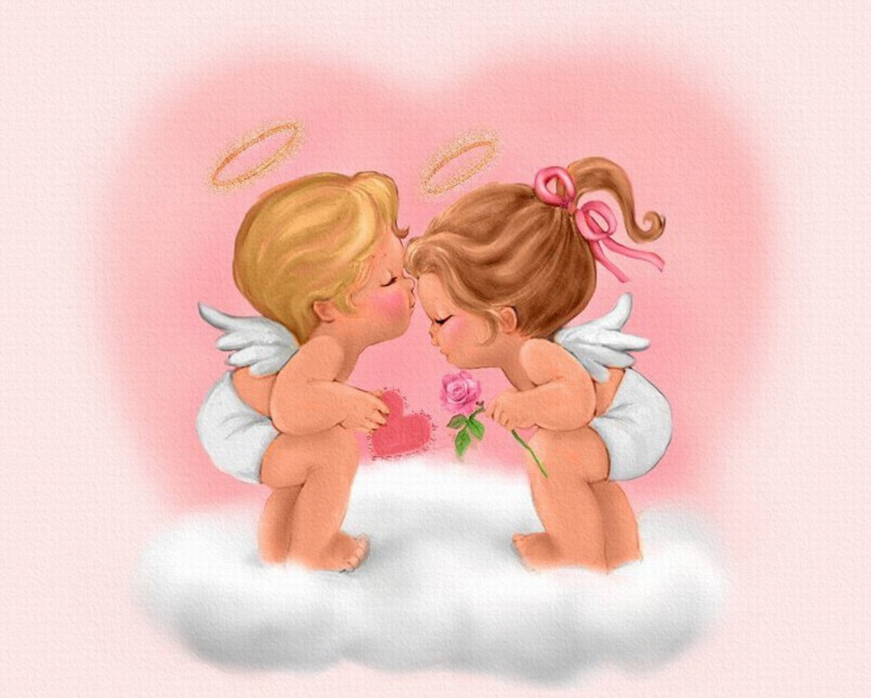
I’ll be your sweetheart, if you will be mine, All my life I’ll be you Valentine.

Slide 8
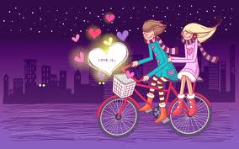
I dream about you
Every night.
Be my Valentine
And hold me tight.

Slide 9
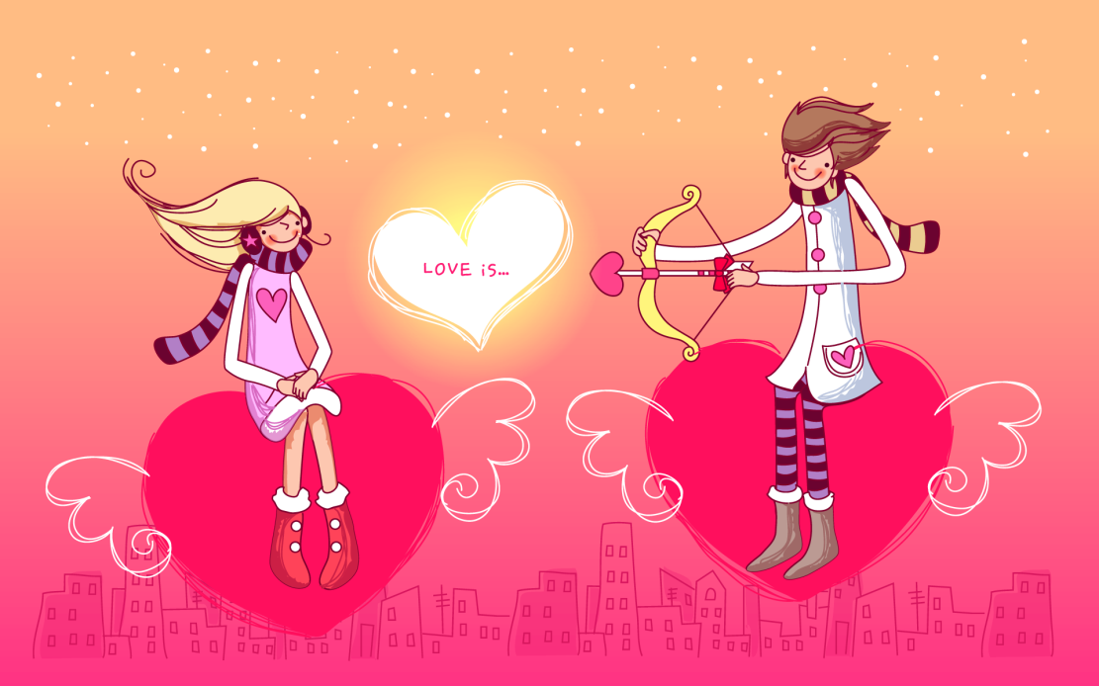
Thinking of you I cannot The sky is high,
The sea is deep.
sleep.
If you love me like I love you
Nothing but death will part us two.

Slide 10
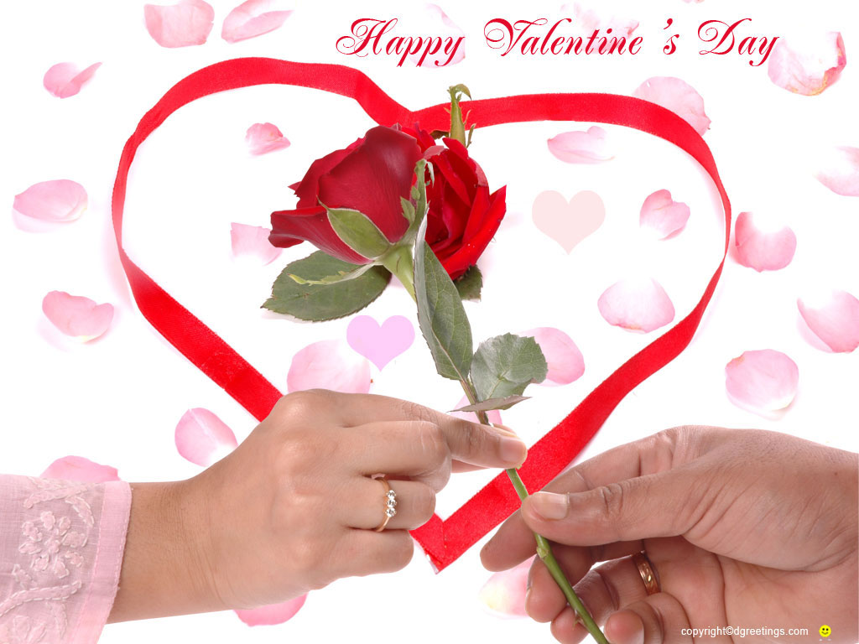
Roses are red.
Violets are blue.
I don’t know the rest.
But I know I LOVE YOU.

Slide 11
Mobile love
Millions of people use digital means of creating and sending Valentine's Day greeting messages such as e-cards, or printable greeting cards. Texting your Valentine message is an easy (although maybe not very romantic!) option. Valentine's Day text messages include:
WUBMV - will you be my Valentine xoxoxoxoxo - hugs and kisses LUWAM<3 - love you with all my heart ImRdy4Luv - I'm ready for love :'-) - I'm so happy, I'm crying ILUVU - I love you

Slide 12
Romeo and Juliet
Shakespeare’s Romeo and Juliet presents a tragic tale of young love that ends in dual suicides. Romeo first takes his life when he wrongly believes Juliet has killed herself during his banishment. When Juliet awakes she finds both Romeo and Paris dead, and so she too claims her life: “O, happy dagger, This is they sheath. There rust, and let me die” (5.3.174-175).

Slide 13
Romeo and Juliet-short summary
7
Next
In William Shakespeare's Romeo and Juliet, a long feud between the Montague and Capulet families disrupts the city of Verona and causes tragic results for Romeo and Juliet. Revenge, love, and a secret marriage force the young star-crossed lovers to grow up quickly — and fate causes them to commit suicide in despair. Contrast and conflict are running themes throughout Shakespeare's play, Romeo and Juliet — one of the Bard's most popular romantic tragedies.

