Slide 1
The Role of Dogs in Our Life The authors of the research: Karens Magakjans Izabella Timpa Marina Volkova Consultant teacher: Tatjana Nikolajenkova
Suņu loma mūsu dzīvē

Slide 2
Introduction
The Topic of the research: The Role of Dogs in Our Life.
Rationale: People have kept dogs since time immemorial . We have got accustomed to their company. They have lived side by side with us in houses and flats.
But what do we know about them?
How do they influence our life?
What is the dog’s aggression? And what should we do in the case of the dog’s aggression?
Do we really need them?
To answer these questions we should learn more about them.
The Aim of the Research: To test on the example of the dog as a pet how it influences people’s life.

Slide 3
Objects of the Research
1) Find some information about the history of the dog’s domestication;
2) To investigate how dogs are used nowadays;
3) Find out the most suitable dog breeds for urban life;
4) Learn what to do in the case of dog’s aggression;
5) Conduct a survey among the classmates about how much they know about dogs;
6) Interview the dog owners about their lifestyle;
7) Process the collected data;
Research Hypothesis: The presence of pets(dogs) in the household contributes to healthy lifestyle of a modern human being.

Slide 4
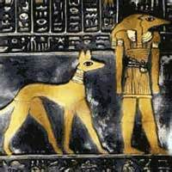
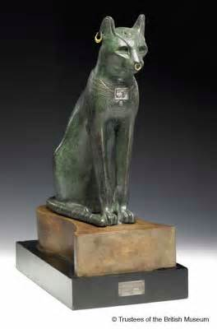
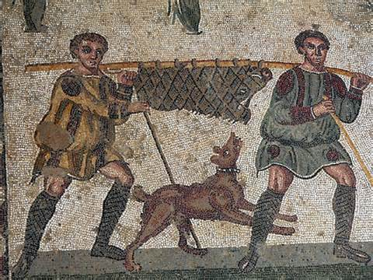
From the History of Pets
A pet (or companion animal) is an animal kept for a person’s company or protection.
Historians don’t know when humans started keeping pets. Dogs were one of the first domestic animal. The ancient Egyptians domesticated wild cats from Africa. The ancient Romans kept horses, dogs, cats, and birds. Monks in China began to raise goldfish in ponds in the 7th century.

Slide 5
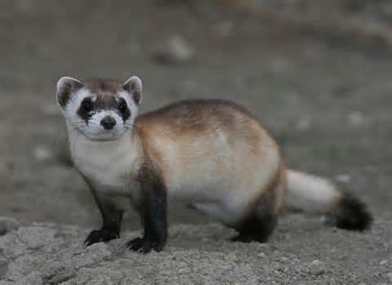
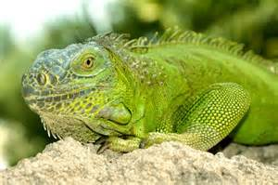
Popular Pets in Modern Society
Top 10 Most Popular Pets in the World
10- Ferrets 9- Iguanas

Slide 6
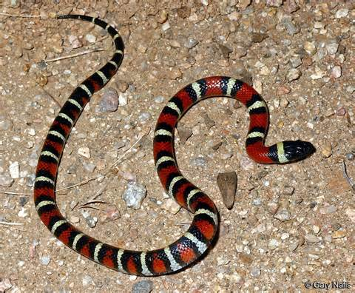
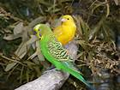
Top 10 most popular Pets in the World
8- Snakes 7- birds

Slide 7
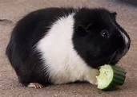
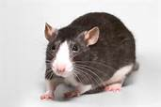
Top 10 most Popular Pets in the World
6- Guinea pigs 5- Rats

Slide 8
Top 10 Most Popular Pets in the World
4- Goldfish 3- Hamsters

Slide 9
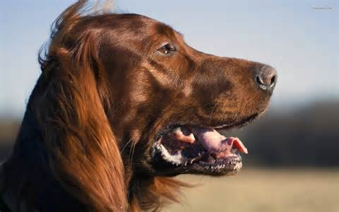
Top 10 most Popular Pets in the World
2- Cats 1- Dogs!

Slide 10
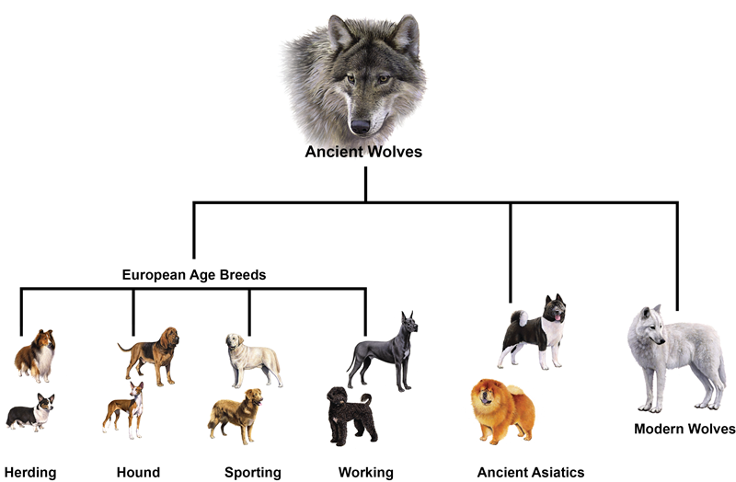
Some Facts From the History of Dog’s Domestication
The history of domestic dog began 20,000 years ago, when the Ancient Man first began to use dogs for hunting. The origin of the domestic dog is probably from the gray wolf. People used wolves for protection, hunting, and guarding.

Slide 11
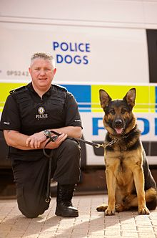
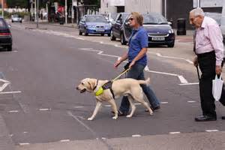
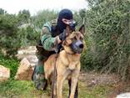
Dogs in the Service of Man
Today dogs live and work with people in so many roles that they have the nickname of ‘man’s best friend’.
Service dogs There are many types of service dogs that help people:
For armed service, customs, police forces, guide dogs for the blind, hearing dogs, therapy dogs and many others.

Slide 12
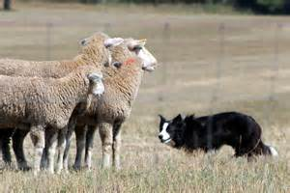
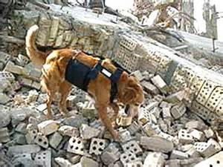
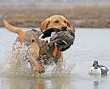
Dogs in the Service of Man
Working dogs The first job is guarding, watching, herding, and hunting.
Today dogs are trained to search for and detect drugs, currency, bombs, weapons at airports, schools, trade centres, etc. .They also search and rescue people.

Slide 13
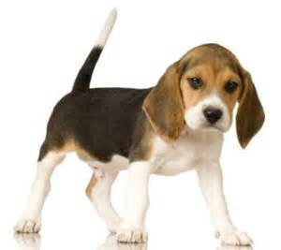
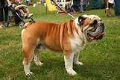
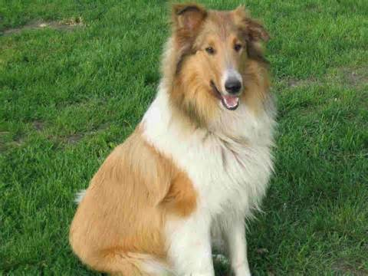
Dogs as Pets
There are a lot of dog breeds in the world. And people like to keep them as pets as they are cute, funny, friendly, and loyal.
Here is a list of the 10 best family dog breeds:
Beagle Bulldog Collie

Slide 14
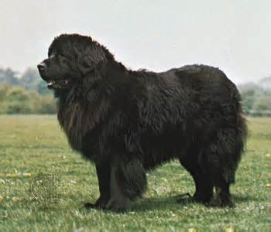
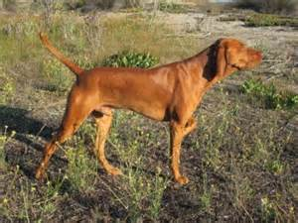
A List of the 10 Best Family Dogs
Newfoundland Vizsla

Slide 15
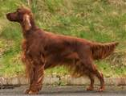
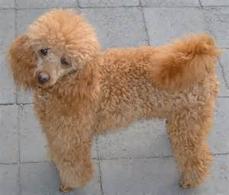
A List of the 10 Best Family Dog Breeds
Irish Setter Poodle

Slide 16
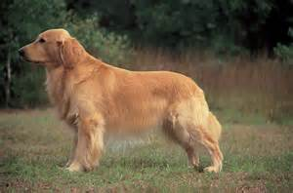
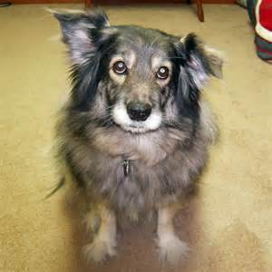
A List of the 10 Best Family Dog Breeds
Golden retriever Mutt(mix breed)

Slide 17
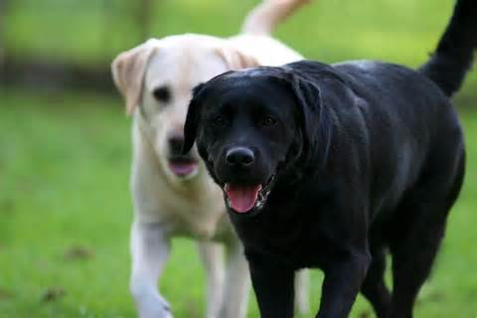
A List of the 10 Best Dog Breeds
Labrador Retriever
One of the most popular breeds . The best choice for the family with kids. Labradors love to please their owners. They are helpful, protective, loving and reliable. They are canine Einsteins!

Slide 18
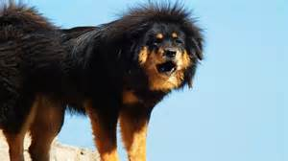
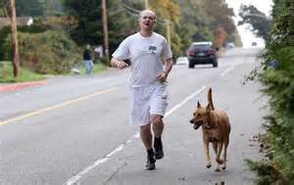
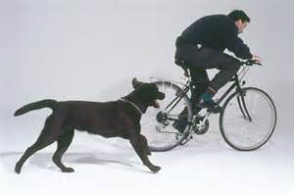
Are dogs ‘Man’s Best Friends’?
Every year a lot of people become the victims of dogs’ aggression. While working on this research two our girls ,the pupils of 4th form were attacked by a dog . They were walking along the street when a huge dog got out of the corner and attacked the girls. Their backs were bitten. There wasn’t the dog’s owner nearby. It was the Tibetian Mastiff.
How to avoid dog’s attack?
-Stay calm
-Don’t give in to fear
-Don’t start yelling or kicking at the dog
-Avoid direct eye contact with a dog
-Claim your own space(place any thing in front of you)
-try to protect your face, chest or throat and runners…
Some dogs chase bikers …

Slide 19
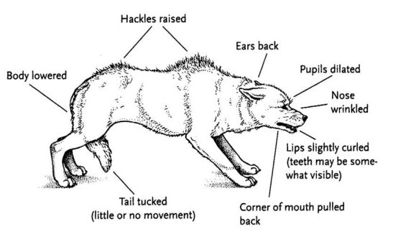
Signs of an Aggressive Dog

Slide 20
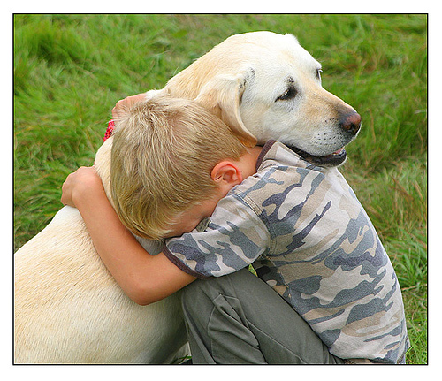
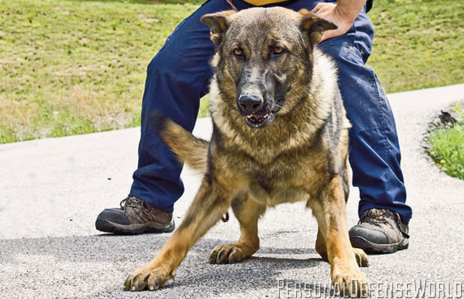
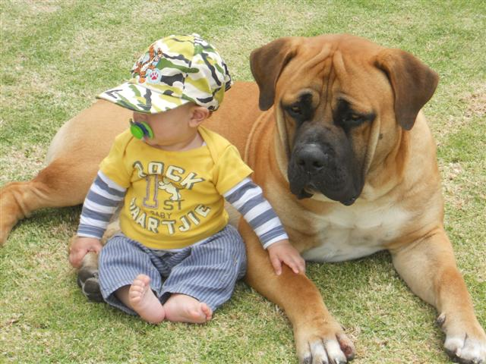
Why Do Dogs Make Good Pets?
However, we are responsible for those who we tamed.
We choose the dogs as our beloved pets, because:
-Dogs make terrific companions.
-Dogs are great protectors.
-Dogs can be great with kids.
-Dogs aren’t be terribly expensive ,on average.
-Dogs do not require tons of care.
And simply, because the dog will never betray.

Slide 21
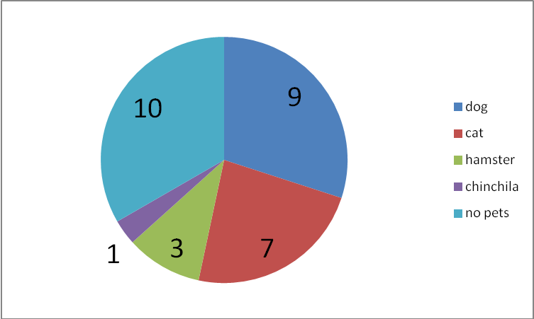
Questionnaire ”My Own Experience’
9 pupils have got a dog. 7 pupils have got a cat. 3 pupils have got a hamster.
1 pupil has got a chinchilla. 10 pupils haven’t got any pets.
The most popular pet in this group is the dog.
30 pupils participated in this survey questionnaire.(4,5 forms)
1.Have you got a pet?

Slide 22
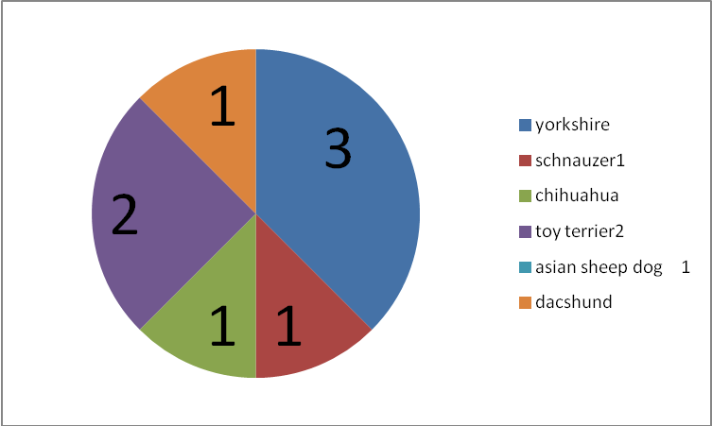
Questionnaire ’My Own Experience’
2. If it is a dog, what breed is it?
The most popular breed is
the Yorkshire Terrier.
Small breeds are predominating.

Slide 23
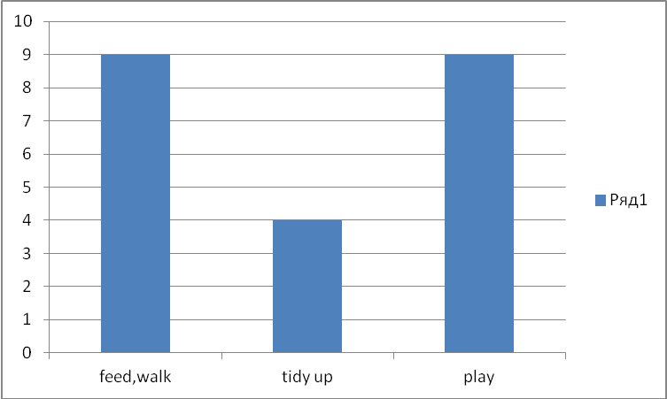
Questionnaire ‘My Own Experience’
How do you look after your dog?
All the children feed, walk and play with their dogs
About half of them tidy up after their dogs.

Slide 24
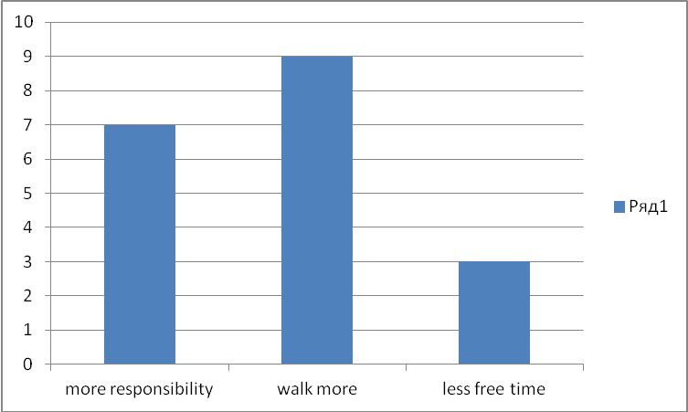
Questionnaire ’My Own Experience’
What has changed in your life with a dog’s appearance?
Most of the children have become more responsible. All of the children started to walk more.

Slide 25
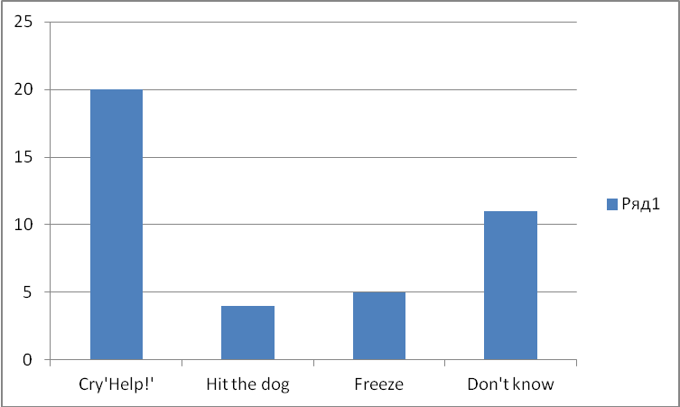
Questionnaire ’My own Experience’
What should you do if you are attacked by the dog?
Most of the children consider they have to cry.

Slide 26
Conclusions
The research was carried out to find out how a dog-pet influences people’s life.
For this purpose some useful and curious information was studied: the domestication of the dog, how dogs are being used nowadays. Also the most suitable dog breeds for urban and family life were determined. The problem of dogs aggression was discussed.
To test the hypothesis 2 questionnaires for the pupils of forms 4 and 5 were compiled and some dog owners were interviewed.
The hypothesis of the research has proved to be true.
Dogs, if they are loved and cared for , help people to be more organized and more responsible. They fill people’s life with positive emotions and help in stressful situations.
‘Dogs are our link to Paradise.’
Milan Kundera.

Slide 27
Thank You for attention!

