Slide 1
Theme of the lesson:
Thanksgiving Day (the last day of November): History, Customs and Traditions
Aims of the lesson:
- to get pupils acquainted with history ,customs and traditions of an English speaking country to motivate them to study a foreign language successfully.
-to strengthen pupils’ listening and speaking skills;
-to develop the skills of co-operation(in groups and pairs);

Slide 2
Plan of the lesson
-Thanksgiving vocabulary;
-Thanksgiving presentation;
-Groups’ presentation;
-Thanksgiving activities:
a)What’s the missing word?
b)choose the right answer
c) anagram solving
-Thanksgiving Feast presentation:
a) lay Thanksgiving Table(jumbled sentences);
-Conclusions;
Evaluation,self-evaluation;
-ending of the lesson: Thanksgiving rhyme;

Slide 3
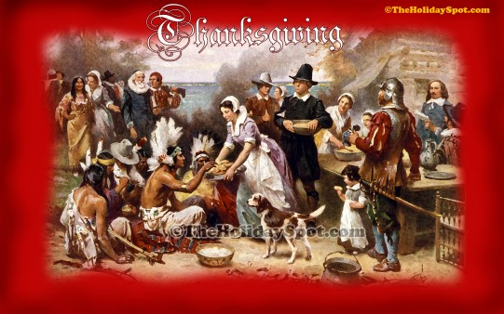

Slide 5
History

Slide 18
Thanksgiving Feast

Slide 22
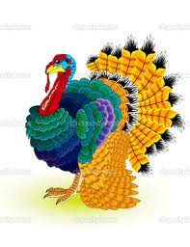
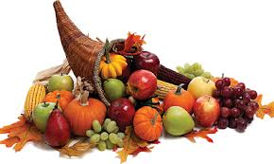
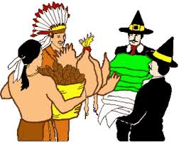
More customs and tradditions
Customs:
Custom of decoration homes:people decorate homes with wreathes, flowers
and lights;
Custom of sending messages: people send loving messages and warm wishes to their relatives;
Traditions:
Travel: people travel long distances to be with their relatives;
Helping others: many generous folks serve food and clothes at homeless shelters;

Slide 23
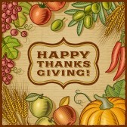

Slide 24
Do the following Thanksgiving activities! Good Luck! What’s the missing word?
Today turkey is still the main dish served on Thanksgiving Day.

Slide 25
The name of their ship was the Mayflower.

Slide 26
The Pilgrims celebrated the first Thanksgiving Day in the fall of 1621.

Slide 27
In the fall of 1621 the Pilgrims had a good harvest.

Slide 28
The Indians taught the Pilgrims how to survive.

Slide 29
Pumpkin pie is the most popular dessert.

Slide 30
Choose the answer:
What do Americans traditionally have for Thanksgiving Day?
A Turkey B Goose C Chicken

Slide 31
Where did the Pilgrims travel from?
A Spain B Egypt C England

Slide 32
What is the traditional Thanksgiving dessert?
A Apple pie B Pudding C Pumpkin pie

Slide 33
In which season did the Pilgrims celebrate the first Thanksgiving Day?
A in spring B in winter C in autumn

Slide 34
What year did the Pilgrims have their first
Thanksgiving Day?
A 1619 B 1520 C 1621

Slide 35
Which televised sport do many people watch on Thanksgiving Day?
A Baseball B Basketball C Football

Slide 36
Thank you!

