Slide 1
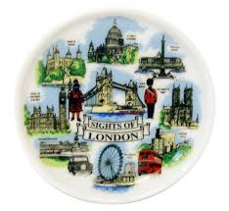
Sights of London

Slide 2
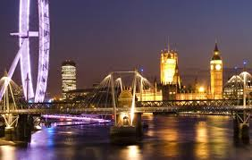
This is London!

Slide 3
This is London
Every year, more than 9 million people come from countries all over the world to visit London. They go to Oxford Street to look at the shops ,or to Harrods.Two million visitors go to the Tower of London. A million more go to see St. Paul’s Cathedral.
But how did all begin…?

Slide 4
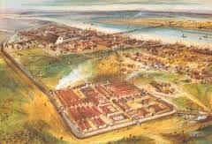
In the beginning (The Romans)
The name of London comes from the Romans. There were people living here before they came, but we don’t know very much about them.The Romans came to England in AD 43. They built houses, bridges ,roads and
called the town Londinium. It was a rich town with about 50,000 people
living in it. But in AD 400 the Romans left Londinium and nobody lived in
the town for many of hundreds o years.
Roman London
in AD 200

Slide 5
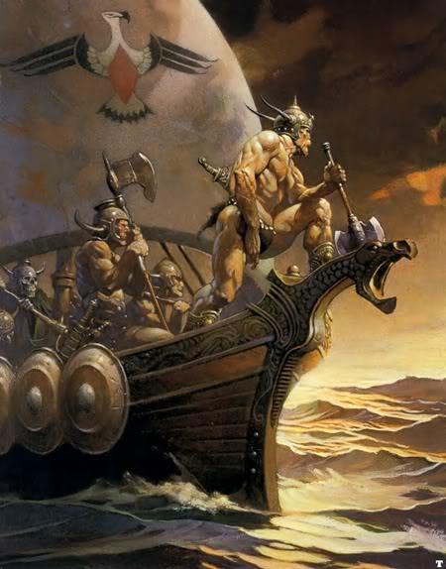
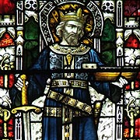
King Alfred
Danish soldiers destroyed more buildings nearly 5 hundred
years later. King Alfred was king of England then. He got the Danes to leave London and his men built the town again.

Slide 6
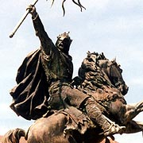
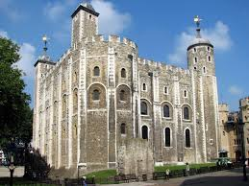
William the Conqueror
In 1066, W.the Conqueror came to England from France to be king .He began to build the Tower of London .

Slide 7
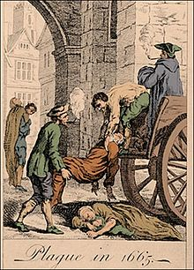
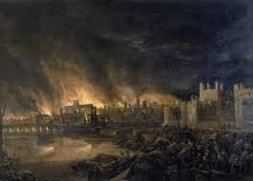
London and Henry the Eighth
When Henry the Eighth was the king 50,000 lived in London again. A lot
of them lived in old and dirty buildings . In 1665, 100,000 people died from the plague. This was the year of ‘The Great Plague’.
A year later ,in 1666 , there was a big fire-the Fire of London. More than a quarter of a million Londoners lost their homes in the fire. It destroyed
St. Paul’s Cathedral and 88 other churches. But the fire also destroyed most of the worst buildings.

Slide 8
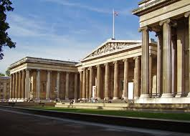
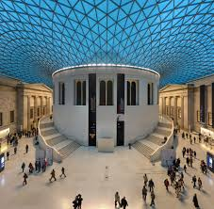
London’s sights
Places to go -Museums and galleries.
The British Museum is the biggest museum in Britain. It was founded in 1753. It contains one of the world's richest collections of antiquities and (until 1997) one of the largest libraries in the world-British Library .The entrance is free.

Slide 9
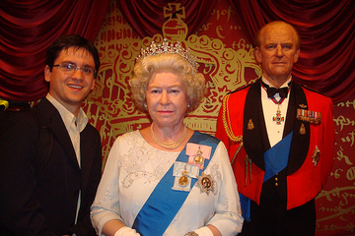
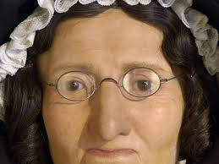
Madam Tussaud’s
Madam Tussaud’s is famous for its people made from wax. You can see
Famous people from the past and famous people of today-A.Lincoln,M.Gandi,Nelson, M.Monroe ,C.Chaplin,S.Stallone,The Beatles…
And in the’Chamber of Horrors ‘you can see some very bad people!

Slide 10
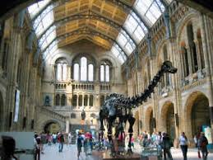
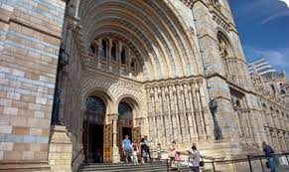
The Natural History Museum
The Natural History Museum was originally part of the British Museum, but the collection became so large that the curators realised that they needed to create an entirely separate museum. The NHM covers all forms of natural history, from dinosaurs to human biology, volcanos to ecology, and fossils to geology.

Slide 11
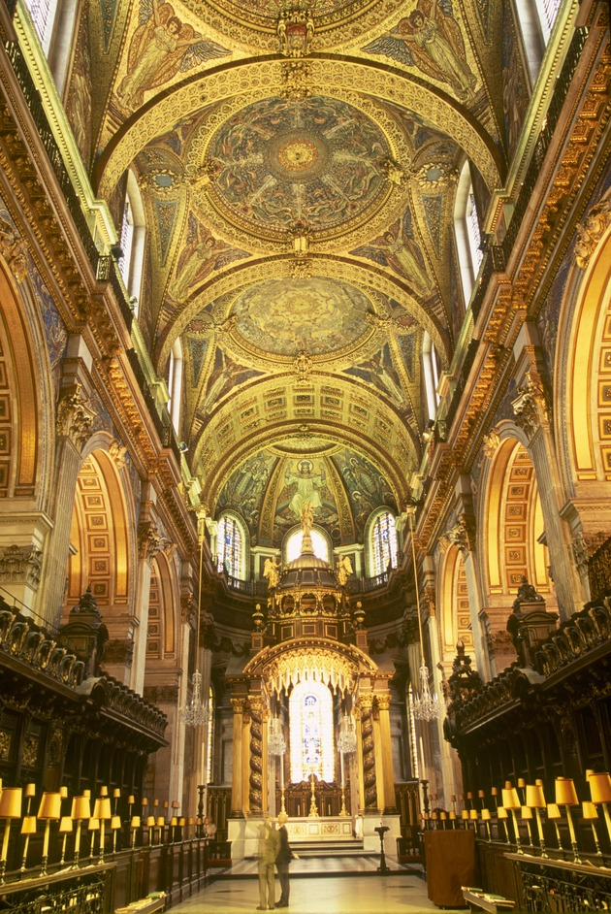
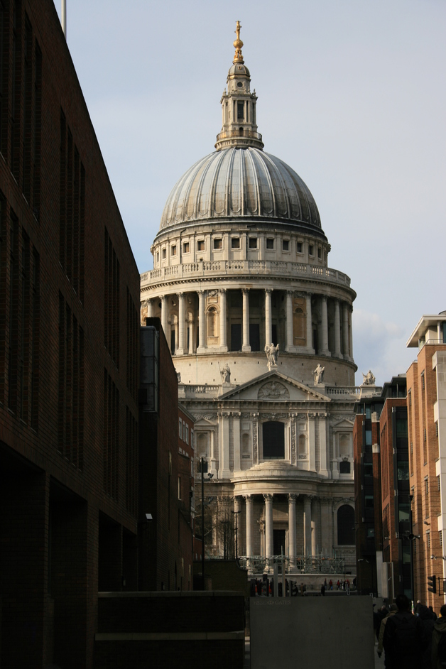
St.Paul’s Cathedral
It was built in AD 604. Then it was destroyed in the Great Fire of London in 1666. The Cathedral was designed by Sir Christopher Wren. It contains the graves of many famous people including Lord Nelson and The Duke Wellington.

Slide 12
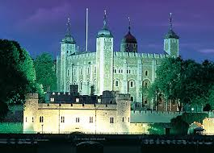
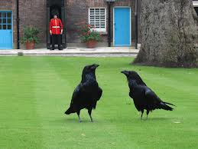
The Tower of London
Fortress, palace, prison, and even place of execution—the Tower of London has filled all these roles and more during nearly a thousand years on the banks of the River Thames in the heart of Great Britain.

Slide 13
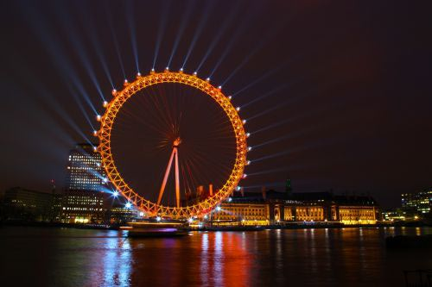
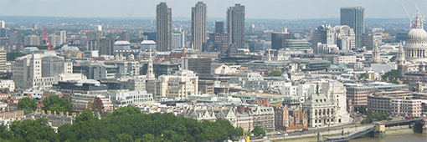
The London Eye
A modern but already very popular tourist attraction is the London Eye, a giant observation wheel located in the Jubilee Gardens on the South Bank. The 135 meter (443ft) tall structure was built as part of London's millennium celebrations.
London seen from the London
Eye

