Slide 1


Slide 2

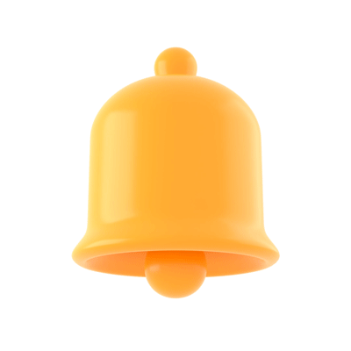
What is your
favourite season?

Slide 3
Hello song
https://www.youtube.com/watch?v=dy_BWXT6Fjc

Slide 4
Today we are going to
revise words “Seasons”,
guess seasons by pictures,
name your favourite season.
write words “Seasons”.

Slide 5
Result of our lesson:
remember four seasons.

Slide 6
How many seasons are there
in the year?
1 winter
2 spring
3 summer
4 autumn

Slide 7
Open your notebook.

Slide 8
Guess!
What season is it?
1 It’s
2 It’s
3 It’s
4 It’s

Slide 9
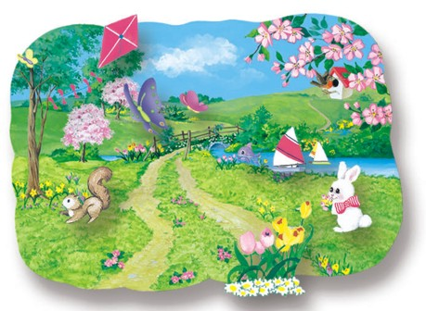

What season is it?
1 It’s spring.

Slide 10

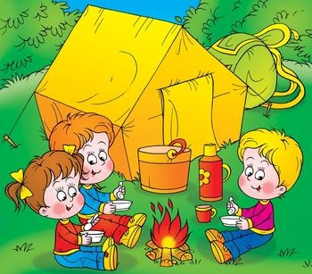
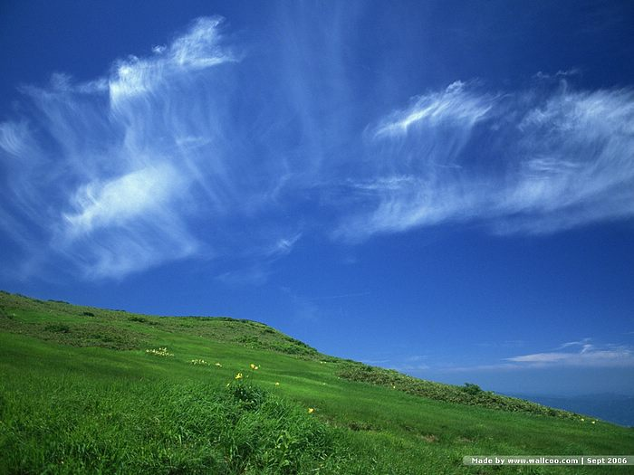

What season is it?
2 It’s summer.

Slide 11
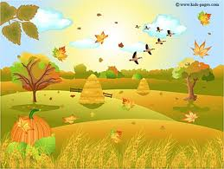
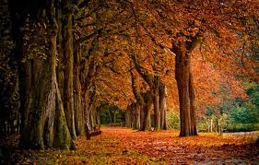
What season is it?
3 It’s autumn/ fall.

Slide 12

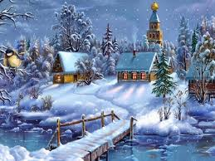
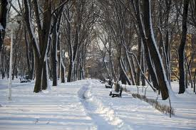
What season is it?
4 It’s winter.

Slide 13
What is your favourite season?
My favourite season is …
My favourite seasons are …
I like all seasons.

Slide 14
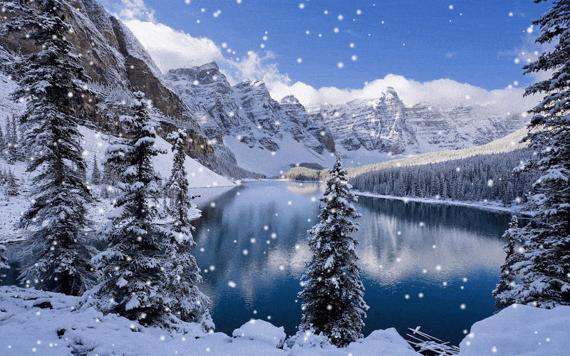
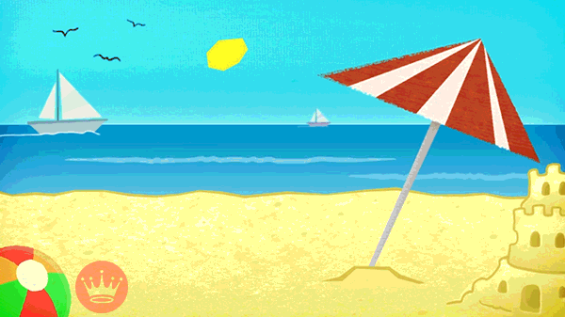
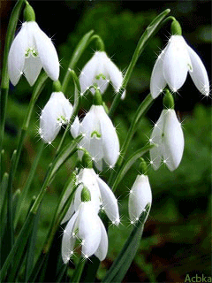
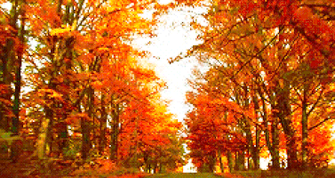
What season is it?

Slide 15
What have I learned?
Name 5 words!

Slide 16
Homework
A
B
Draw and name 4 seasons (A4)
C
D

Slide 17



