Slide 1
1.- I work ten hours a day.
If I (have) _________________________ more free time, I (practise) ____________________ some sport.
2.- Jane’s always late for school.
If she (be) ___________________ punctual, the teacher (not punish)
___________________ her almost every day.
3.- She’ll probably go to the Old Students’ Party.
If she (go) _________________________, she (meet) __________ her old school mates.
4.- You should carry an umbrella.
You (get) ____________ wet if you (not carry)_____________ one.
5.- We didn’t pay the phone bill.
If we (pay) _________ it, they (not cut) ______________the line off.

Slide 2
Finish the following sentences with the correct conditional.
If I hadn’t drunk so much coffee last night...
If I had time this week...
I would have brought more money.....
If I had known my favourite film was on TV last night....
If I remember your birthday next month....
Plants die....
What would you do....
If I went to bed earlier....
If he hadn’t been drunk....
If I win the lottery....

Slide 3
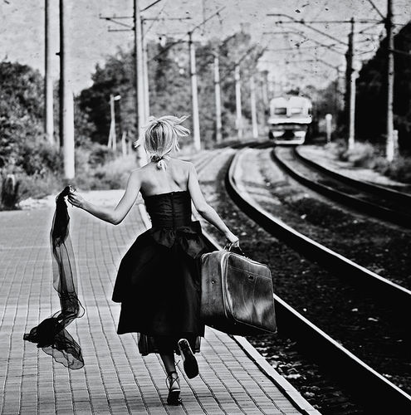

Slide 4
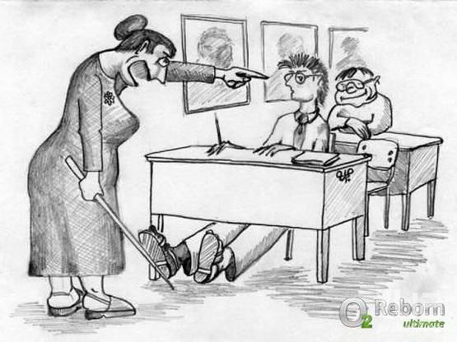

Slide 6
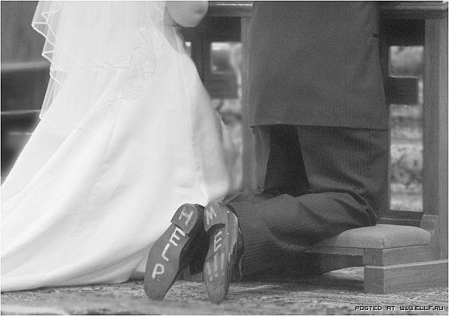

Slide 7
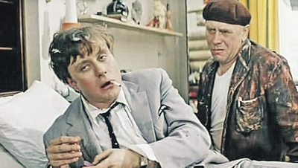

Slide 8
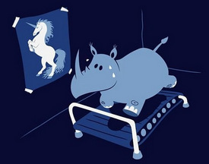

Slide 9
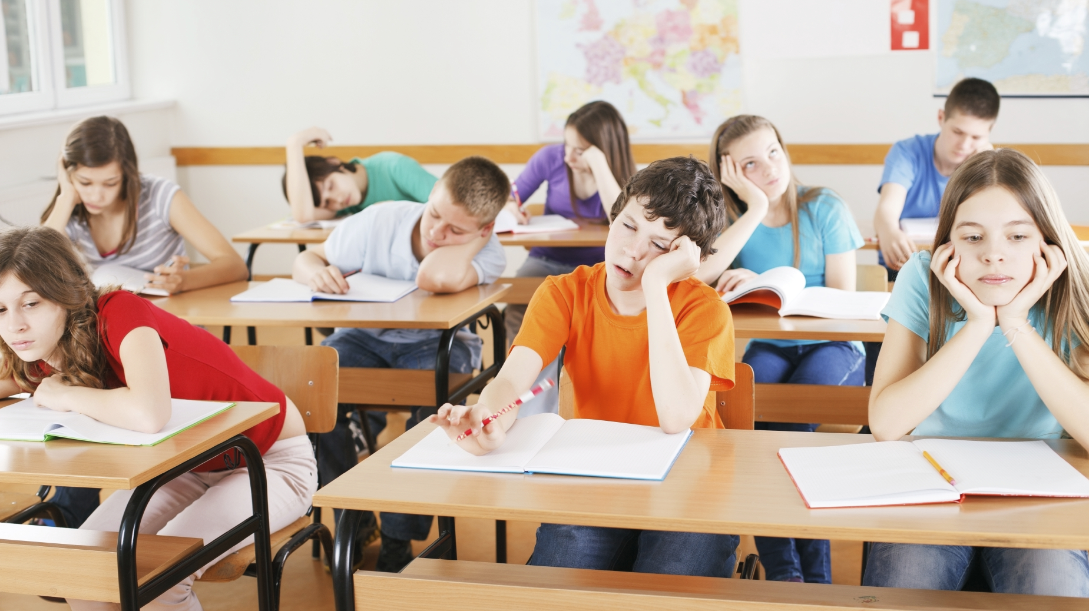

Slide 10
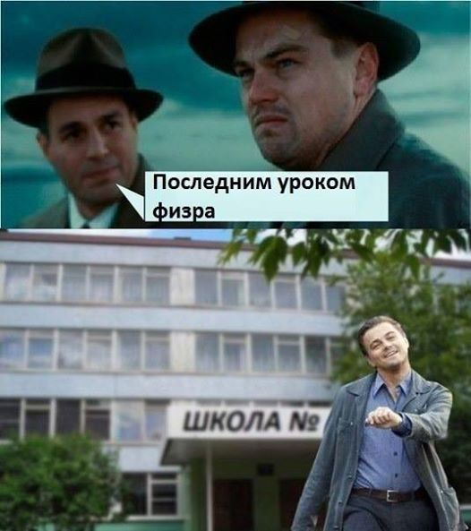
PE is the last lesson today.

Slide 11
