Slide 1
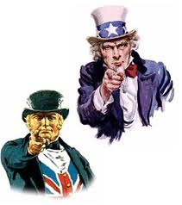
British vs American English
autumn
cinema (Let’s go to the cinema)
lorry
underground
motorway
chemist’s
flat
lift
pavement
Petrol (Petrol Station)
Telephone box
rubbish
crisps
chips(French Fries in McDonald's)
biscuits
movies (Let’s go to the movies)
elevator
subway
potato chips
drugstore
cookies
fall
French fries
Gas/gasoline (Gas station)
Telephone booth
truck
sidewalk
garbage
Freeway
apartment

Slide 2
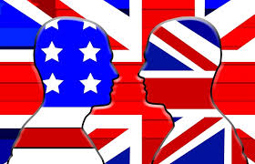
sweets
aubergine
tin
fridge
wardrobe
trainers
jumper
trousers
nappy
surgery
garden
football
holiday
rubber
queue [kju:]
sweater
eraser
soccer
line
backyard / yard
can
vacation
diaper
doctor's office
closet
candies
freezer
eggplant
sneakers
pants

Slide 3
1. In North America, a person drives a truck down the road. In Great Britain, a person drives a________________ .
2. In Great Britain, the front of a car is called a bonnet. In North America, the front of a car is called a______________ .
3. In North America, the back of the car has a trunk. In Great Britain, the back of the car has a_______________ .
4. In Great Britain, people put petrol in their cars to make them go. In North America, people put_____________ in their cars.
5. In North America, babies wear diapers before they learn to use the toilet. In Great Britain, babies wear_______________ .
6. In Great Britain, food can be bought in tins. In North America, food is bought in________ .
7. In North America, people eat cookies. In Great Britain, the same things are called ______________.
8. In Great Britain, people play football. In North America, the game is called__________ .
9. In North America, you can see in the dark if you use a flashlight. In Great Britain, you use a_______________ to see in the dark.
10. In Great Britain, you go up the building in a lift. In North America, you use an _________ .
11. In North America, when you make a mistake with a pencil, you can erase it with an eraser. In Great Britain, you use a_______________ .

