Slide 1
WORD FORMATION PREFIXES

Slide 2
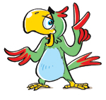
Negative prefixes:
il- mis-
in- dis-
im- ir-

Slide 3
Form the words with the help of the prefixes il-, im-, in-, dis-, ir-, miss-
Responsible
Parity
Understand
Mortal
Regular
Order
Legal
Dependence
Appear
irresponsible
imparity
misunderstand
immortal
irregular
disorder
illegal
independence
disappear

Slide 4
Complete the chart.
BASE WORD | il- | im- | in- | ir- | dis- | mis-
1. polite
2. literate
3. relevant
4. honest
5. respective
6. understand
7. definite

Slide 5
Check your answers.
BASE WORD | il- | im- | in- | ir- | dis- | mis-
1. polite |  | +
2. literate | +
3. relevant |  |  |  | +
4. honest |  |  |  |  | +
5. respective |  |  |  | +
6. understand |  |  |  |  |  | +
7. definite |  |  | +

Slide 6
Identify the words which need prefixes and add them.
Santa Claus was usually accompanied by Black Peter, an elf, who punished _____obedient children.
She is rather ____trustful person to stranger.
It was ____rational to react in this manner.
It is ___legal to drive while intoxicated.
It was ___modest of them to say that.
It would be ___accurate to say that she has been dismissed.
You were ___attantive at the lecture.

Slide 7
Check your answers
Santa Claus was usually accompanied by Black Peter, an elf, who punished disobedient children.
She is rather distrustful person to stranger.
It was irrational to react in this manner.
It is illegal to drive while intoxicated.
It was immodest of them to say that.
It would be inaccurate to say that she has been dismissed.
You were inattantive at the lecture.

Slide 8
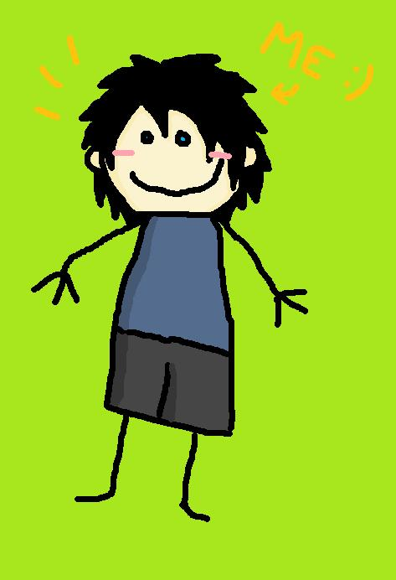
Your home task :
Write the composition “What a naughty child!”
Imagine that you are a primary school teacher. One of your pupils is very undisciplined. You have a talk with his/her parents. Say some words about this child.

Slide 9
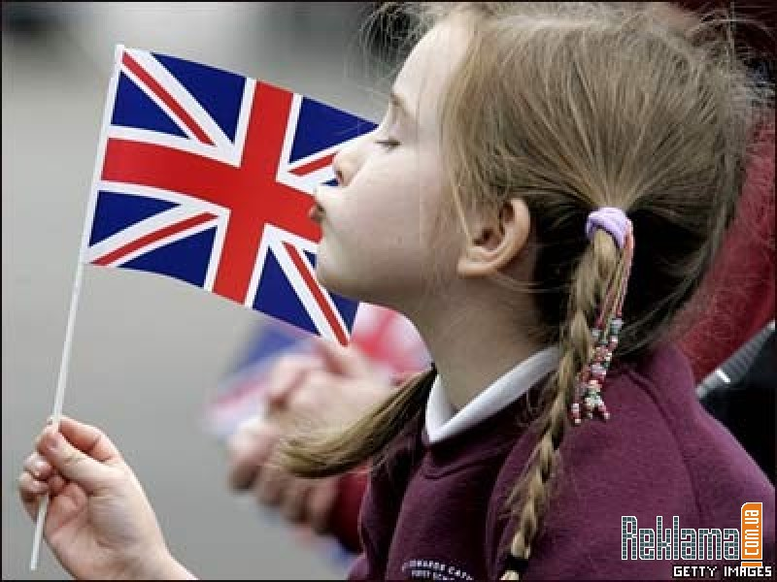
Well done!!!

